Slide 1

Abortion Research Methods
Dr. Wakgari Deressa and Dr. Elizabeth Sully
October 26th, 2022

Slide 2
Introduction to Abortion Research
Notes:
30 MINUTES

Slide 3
Why is it important to study abortion?
Abortion is extremely common throughout the world; an estimated 73 million abortions occur each year. In Sub-Saharan Africa, the abortion rate is estimated to be 33 per 1,000 women of reproductive age
  And yet, there is a lot we don’t know about abortion because it is often not talked about nor properly recorded
Unsafe abortion is a public health problem: it is a leading cause of maternal death and morbidity
Lack of access to abortion is a human rights issue: reproductive rights, including access to abortion, are internationally recognized human rights

Slide 4
Why is it important to study abortion?
Research on abortion has taught us that:
  Maternal morbidity and mortality rates decline promptly when safe abortion services are made available
  In many parts of the world, unsafe abortion still ranks as a leading cause of death and injury among women
  When done by a trained provider or by a woman herself with the appropriate medications and correct information, abortion is very safe
  Denying a woman an abortion has negative economic, mental, and physical health impacts on women
Research on abortion can be used to advocate for more liberal abortion laws and a better enabling environment

Slide 5
The Impact of Abortion Research on Policy
Colombia: New abortion estimates were key in the push to decriminalize abortion (including the highest court’s 2022 decision to decriminalize abortion up to 24 weeks) and evidence helped fend off multiple legal challenges.
Nepal: The Beyond Beijing Committee, a Nepal-based women’s advocacy group, used data from the Guttmacher/CREHPA abortion incidence study to promote greater access to abortion in Nepal and lobbied the Nepalese government to include abortion in the Safe Motherhood and Reproductive Health Rights Act. They succeeded: the bill, which passed in October 2018, explicitly names safe abortion as a human right and makes reproductive healthcare free-of-charge in public health facilities.
Nigeria: In February 2018, the Nigeria government released official national guidelines on safe termination of pregnancy that extensively cited evidence on abortion in Nigeria.

Slide 6
Types of questions about abortion we may want to answer
What is the incidence of abortion? How common is abortion in a certain community/region/country/the world?
How safe is abortion? What types of complications do people having abortion experience?
Where and how do people access abortion?
What are the lived experiences of people having abortion?
What is the cost of treating post-abortion complications and providing safe abortion care?

Slide 7
Brainstorm
Brainstorm a research question about abortion you would like to answer. Briefly, consider what the study methodology might be.

Slide 8
Abortion Research Methodologies:
Methods to study abortion incidence
Notes:
Why do you think incidence is important to study?
How would you try to measure it?
Why can’t we just ask women directly?
- US experience where we can compare to good data, and see large biases in who reports
- PMA experience – inconsistency with over half of women reporting abortions between survey rounds – not just who will disclose, but more factors involved
- Limitations to facility-based approaches to finding women who have had abortions - who is missing?
Where restricted, need new methods

Slide 9
Abortion Incidence Complications Method (AICM)
Notes:
1 HOUR 30 MINUTES

Slide 10
AICM Methodology
The goal of the AICM is to produce estimates of abortion incidence in various settings:
Between the early 1990s to the present, AICM
  Has been applied in about 25 countries
  Published in peer-reviewed journals
  Adapted and improved over the past two decades
  Used widely, including by WHO
Continued importance of validating estimates through multiple methods

Slide 11




Abortion Incidence Complications Methodology (AICM)
Have complications from abortion; receives care in health facilities
Estimated from HFS
Estimated using KIS
Have complications from abortion but are untreated / not seen in health facilities
Have no complications from abortion
Notes:
In Ethiopia with legal abortion, you could carve out another group on the top of iceberg for the facility-based abortions which are also visible. Count separately and add to the total.
With a lot of other methods, we don’t know what the data we get represents and who is missing. The idea of this is approach is to take the thing we know we can see and can measure, and try to back=out from there the true incidence estimates

Slide 12
Key Data Collection Instruments
Health Facilities Survey (HFS)
In-person interview with healthcare providers in facilities
Sampling universe: All facilities that have the capacity to provide PAC in the public, private and NGO sectors
Knowledgeable Informant Survey (KIS)
Sample of experts from across the country of interest (experts include Ob/Gyn, nurses, midwives, pharmacists, NGO staff, DMOs, researchers, TBAs, Community leaders)
Collects information on women (separated by urban/rural & poor/non-poor), including: type of provider and procedure; probability of complications, by each type of provider; Probability of getting PAC treatment in a health facility
Collects information on: Number of PAC cases seen in last month and in average month; PAC treatment provided; PAC contraceptive counseling and services
Used to calculate the multiplier
Notes:
Thee AICM uses data from two component surveys: HFS and KIS. KIS is also sometimes referred to as the HPS (health professionals survey)
Sampling – sometimes hard to define who has the capacity versus where else it may be happening. Sometimes may occur in doctors private practices but those are often unlisted and we assume that the proportion is a small share of total cases and exclude from the sampling frame.
Often set up a stratified sample – purposefully sample all higher level facilities given caseload volumns there, and regional proportions of lower-level facilities
- benefit to facility sample, rather than just selecting a few facilities – you can generalize up to a representative area
KIS sample – really important who is selected – need to make sure you are getting experts, a wide set of perspectives on abortion, and need to be careful since data won’t be weighted that you don’t have too many people with just view (eg. doctors who only know about facility-based abortions).

Slide 13
What is a multiplier?
Remember the iceberg – the multiplier helps to estimate # of “invisible” cases
The multiplier answers the question: For every 1 woman who have an induced abortion and is treated for a complication in a health facility, how many other women have an induced abortion but did not:
  result in complications OR
  receive treatment in a health facility for a complication

Slide 14
# of women who induce abortion and are treated for post-abortion complications
Health
Facility
Survey
(HFS)
Public sector
Private sector
NGOs
Total # of PAC cases
-
Miscarriages
% who induce abortion and experience no complications
X
Knowledgeable Informants Survey
(KIS)
Knowledgeable informants
Multiplier
% who induce abortion & have complications that go untreated
Total number of induced abortions
Notes:
In some settings you might use an HFS just for data in public or private sector facilities, but some NGOs have good M&E data that can be used (like in ET). But sometimes that M&E data doesn’t differentiate PAC and SAC, and need to separate them with assumptions.

Slide 15
Steps in Estimating Abortion Incidence via the AICM
Total annual PAC caseloads*
Referrals
Annual PAC due to mis-carriages
Annual PAC cases due to abortion

Slide 16
Step 1. Estimate the number of PAC patients
HFS obtains these estimates directly by asking about PAC caseloads at facilities
  Within the past month/average month * 12
  Apply sample weights to obtain national estimate
In some countries, NGOs known to have reliable service statistics are asked for national caseload estimates (instead of weighting up a sample from these facilities).
However, these include all PAC patients, including
  Stemming from facility and out-of-facility abortions
  Induced and spontaneous
  Double-counted referrals?
Notes:
What is the quality of health records at facility on CAC? Sometimes improves as access expands and services are normalized. What are you views on the current situation in Ethiopia?
Sometimes data collected from health records at the end of the survey and compared to respondent answers.
Very large facilities may provide PAC in different departments, so survey administered multiple times in the same facility to providers in each department.

Slide 17

Steps in Estimating Abortion Incidence via the AICM
Total annual PAC caseloads*
Referrals
Annual PAC due to mis-carriages
Annual PAC cases due to abortion
*Estimated by asking providers for their estimates of typical and last month. PAC cases are often undercounted in logbooks and official records
Notes:
Will talk later about another survey called the prospective morbidity survey, which can provide a second source of caseload data to triangulate with HFS data

Slide 18
Step 2. Estimate the number of women treated for complications of induced abortion
Subtract three things from the estimate in Step 1:
PAC cases stemming from miscarriage
  Assume: only late miscarriages (13-21 weeks gestation) will be accompanied by complications requiring care
  Assume: # of miscarriages requiring care = 3.4% # of live births
  Assume: # women who deliver in facility = % of women with complicated miscarriage who obtain care in a facility
Referral cases (to avoid double-counting cases)
Notes:
Not great data on miscarriages - uses life table data from the US in the 1980s

Slide 19
Steps in Estimating Abortion Incidence via the AICM
Total annual PAC caseloads*
Referrals
Annual PAC due to miscarriages
Annual PAC cases due to abortion
Remove cases that were initially treated at a facility but then referred to a higher level facility for more care

Slide 20
Steps in Estimating Abortion Incidence via the AICM
Total annual PAC caseloads*
Referrals
Annual PAC due to miscarriages
Annual PAC cases due to abortion
Previous studies estimate that 2nd trimester miscarriages account for 3.41% of live births. Calculate this at regional level and remove from regional PAC estimates

Slide 21
Step 3. Estimate the number of all abortions
Step 2 specifies the women who had an induced abortion, experienced a complication, and obtained treatment in a facility
  Remember the iceberg: these are the “visible” cases.
To estimate the “invisible” cases, we construct a multiplier using the KIS
  The multiplier represents, for each complication stemming from an out-of-facility induced abortion, how many out-of-facility induced abortions occurred for which treatment was not required or not obtained.
Applying the multiplier (calculated from data collected in the KIS) to the estimate obtained in Step 2 yields an estimate of all induced abortions in the country.
Notes:
Refer you to Zimbabwe AICM published in 2018 – has a technical appendix with the full mathematical formula for the multiplier and AICM calculation, step-by-step.

Slide 22
Steps in Estimating Abortion Incidence via the AICM
Annual PAC cases due to abortion
Multiplier
Total number of induced abortions
Notes:
Will talk soon about how this approach is modified in a setting like ET where there are legal facility-based abortions occurring

Slide 23
Sampling Considerations
  KIS sampling: Depending on the size of the community, HPS sample may range from 50 to 200 experts selected purposively from across the area of interest:
      Health providers: OB/GYNs, medical officers, nurse/midwife
      Researchers, teachers
      Policy makers, program planners
      Reproductive health NGO workers
      Community leaders, welfare officers
      Activists, lawyers, media practitioners
  Data are collected via in-person interviews with the key informants by 2-4 experienced interviewers and preferably fairly senior people.
Notes:
Who would know about out-of-facility abortions in Ethiopia?

Slide 24
Pros and Cons of the AICM Methodology
Pros:
To date, the best method we have for estimating abortion incidence
Cons:
Annual PAC due to miscarriages estimate is based on old data from the United States
May not be well suited to capture growing use of medication abortion outside of facilities
Provides critical data on post-abortion care demand and service provision
Setting up an appropriate sampling frame of health facilities can be difficult
Notes:
Problems with HFS sample
Caseloads from out of the country - eg. border facilities with much higher caseloads
In Zimbabwe, facilities providing miso that weren’t authorized by govt to do so but were anyways – supplemented with phone interview afterwards

Slide 25
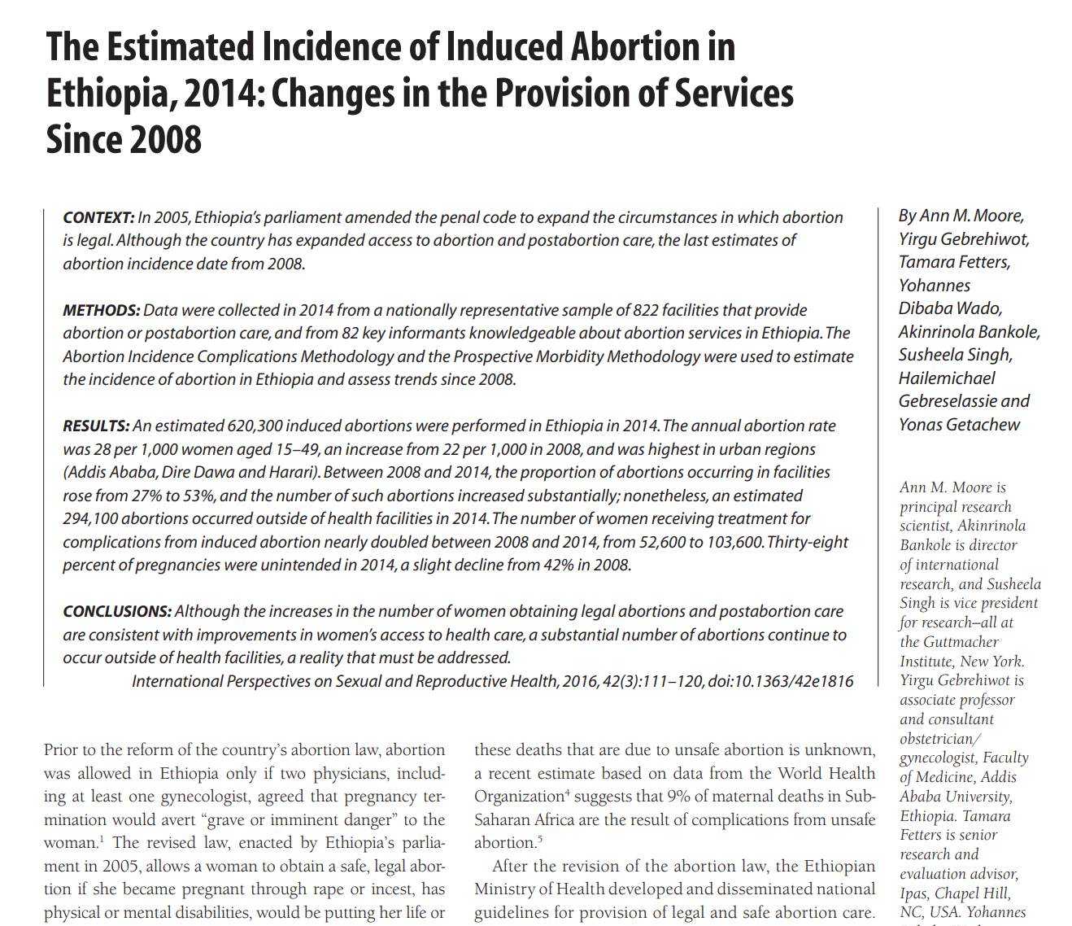
AICM Evidence from Ethiopia
The last AICM was conducted in Ethiopia in 2014
This AICM estimated:
  620,300 induced abortions were performed in Ethiopia in 2014
  The annual abortion rate was 28 per 1,000 women aged 15–49, and was highest in urban regions (Addis Ababa, Dire Dawa and Harari)
  An estimated 53%, or 294,100 abortions occurred in of health facilities in 2014 (up from 27% in 2008)
  An estimated 103,600 women received treatment for complications from induced abortion in 2014
Notes:
- From a different source, but asked women self-reporting abortions in 2020 PMA GGR study how many facility based, and over 70% now.

Slide 26
Adaptations to the AICM
Recently, adaptations have been made to the AICM¹ to account for:
  The increased use of misoprostol²
    Modification of KIS, whereas HFS remains the same
  Countries where abortion laws are liberal but clandestine, unsafe abortion is prevalent and coexists with substantial numbers of safe, legal abortions³
    Modification of both KIS and HFS
    Age-Specific AICM
¹Singh S, et al. Estimating Abortion Incidence: Assessment of a Widely Used Indirect Method. Population Research and Policy Review. 2019;38:429-458.
²Chae S, et al. The incidence of induced abortion in Kinshasa, Democratic Republic of Congo, 2016. Plos One. 2017
³Singh S, et al. The incidence of menstrual regulation procedures and abortion in Bangladesh, 2014. International Perspectives on Sexual and Reproductive Health. 2017;43(1).
Notes:
Other examples –
Drug sale data in India used instead of multiplier
Abortions performed outside country – hard to measure – in Zim asked in HPS the proportion they thought took place in other countries
Concerns with KIS
Multiplier from CBS (Ghana, Indonesia)
Asking respondents about the certainty of their knowledge and weighting data based on this (Zim)

Slide 27
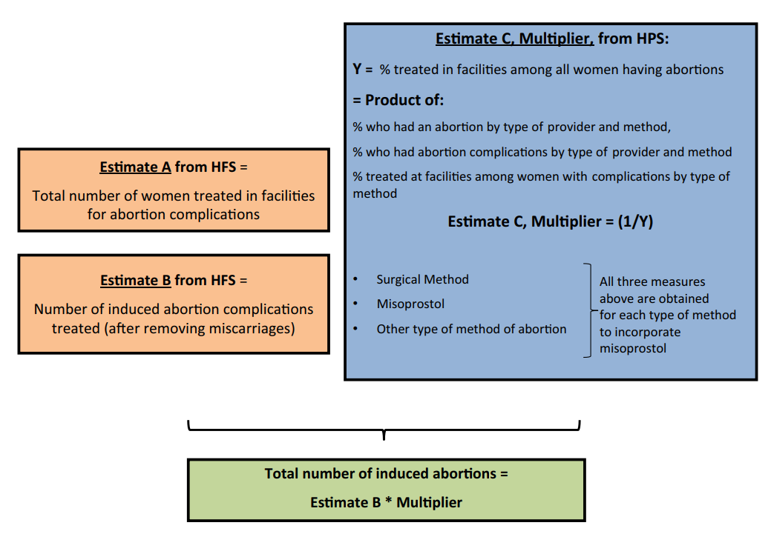
Adaptations to the AICM: increased use of misoprostol
Expansion of the KIS (called HPS in this graphic) questionnaire to collect information on the distribution of all women having abortions according to three categories of methods:
  Medication abortion
  Surgical methods
  Other methods
    And within each category, by distribution by type of provider

Slide 28
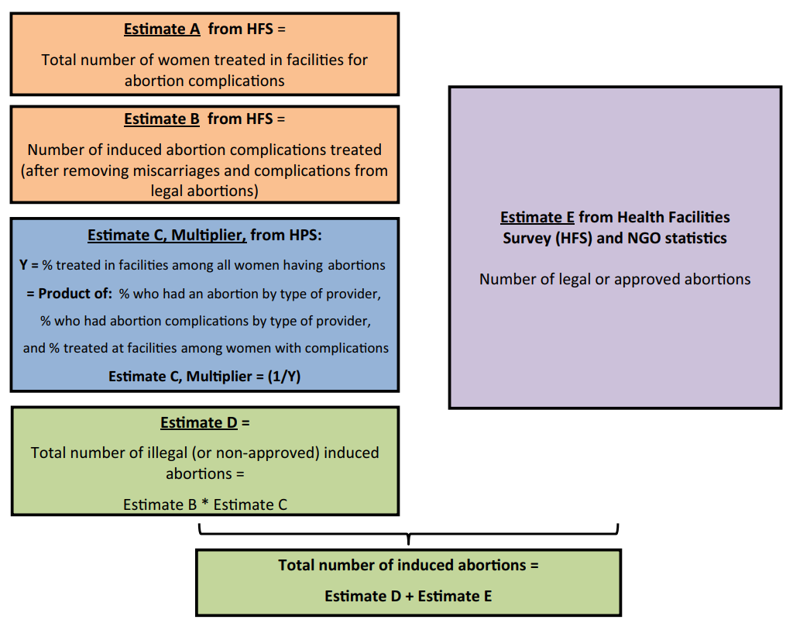
Adaptations to the AICM: mixed legal settings
Expansion of HFS to obtain counts of legal abortions and PAC caseload
Expansion of KIS (HPS) to obtain information on the proportion obtaining abortions from approved/legal providers separate from those obtaining abortions from non approved/illegal providers
Notes:
Language of legal versus illegal, clandestine, facility versus out of facility - does not equal safe/unsafe

Slide 29
Abortion measurement methodologies and tools
https://osf.io/c3xhm/

Slide 30
Indirect Social Network-Based Approaches
Notes:
45 MINUTES
What other approaches have you heard of for measuring abortion incidence?
Self-reporting - numerator problem
But these other methods we have to look for biases in both the numerator and the denominator
Methods I am going to talk about include in GGR study in 2018 and 2020 – 2018 data already public and 2020 will be made public soon but can be made accessible to other researchers interested in using it

Slide 31
Social Network Based Approaches
Emerged as a promising solution for measuring abortion incidence
There are numerous social network-based approaches, but all rely on two main assumptions:
Women will be more likely to report on abortions within their social networks as opposed to their own
Women’s social networks can be used to generate appropriate surrogate samples that are generalizable to the underlying population
Notes:
Numerator – might be able to improve willingness to report when someone else
Demoninator - taking a representative survey and collecting data on a surrogate sample – not clear how representative that will be

Slide 32
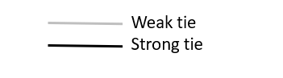
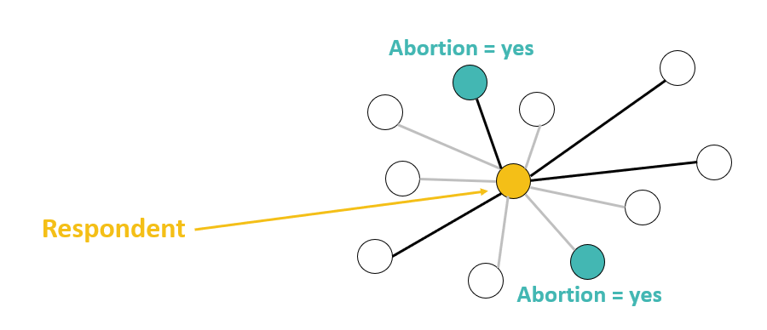
Social Network Based Approaches
One of the main distinguishing factors of these different methods is how social ties are defined.
Some look only at the strong ties (dark black line; close friends or relatives), while others ask about strong and weak ties (acquaintances).

Slide 33
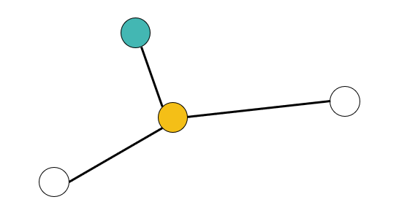
Confidante Method
The Confidante Method assumes that abortion information will be most accurate and complete when women are asked to report on the abortions of their closest friends and confidantes (strong ties only)
  It asks women to list only up to three women who meet this definition; this was designed to limit biases related to a person’s inability to accurately list all close friends
  It also requires the tie to be reciprocal (both someone with whom the respondent shares secrets, and who shares secrets with the respondent)
For each confidante, we ask whether she has had an abortion & follow-up questions about the circumstances of that abortion
Notes:
The Confidante Method was then created to build off of the work of Rossier and Yeatman.
Again, The assumption here is that abortion information will be most accurate and complete when women are asked to report on their closest friends and confidantes
However, instead of asking women to think of all of their close friends, the method asks women to only list up to three women who meet the tie definition. This was designed to limit biases related to women’s inability to accurately list all close friends.
The tie definition is also different from the ATPR and Best Friend approach, as it states that the relationship with the onfidante has to be receiprocal. It has to be someone with whom the respondent shares secrets, but who also shares secrets with the respondents.
Then, for each confidante, we ask whether she has had an abortion plus follow-up questions about the circumstances of that abortion
However, recent work has suggested that The confidante Method’s requirements of strong ties and a set number of reported confidantes can lead to an unrepresentative surrogate sample. As such, we may be trading information completeness for another set of biases in our estimates
Selection bias into who is chosen as a confidante
Missing confidantes for a substantial portion of the sample (>50% in some countries)
Transmission bias problem – will talk more about this later

Slide 34
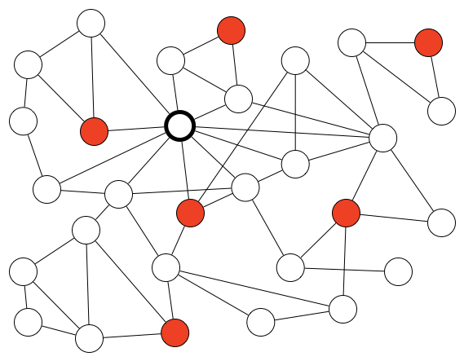
Confidante Method
What we want to know
What we measure
The population (women aged 15-49)
Surrogate sample of up to three confidantes per respondent
Notes:
In the Confidante Method, each respondent is asked to think of up to three women with whom she has a reciprocal relationship that includes sharing secrets. For each confidante, information is collected on her socio-demographic characteristics and whether she has had an abortion in a designated window of time. The main strength of the confidante method is that it affords a sense of anonymity while still allowing for the collection of women’s background characteristics (an opportunity for sub-group estimation) and detailed information about each reported abortion, as respondents can provide more information for a smaller number of abortions.

Slide 35
Confidante Method: determining surrogate sample and homophily
Social tied definition:
  Think of women with whom you share intimate secrets and who share intimate secrets with you. These women should also be people with whom you have been close to for at least a year or more, are 15-49 years of age and live in Ethiopia.
Asked to think about:
  Confidante 1 as most likely to share intimate secrets with her
  Confidante 2 as second most likely
  Confidante 3 as third most likely
Measure several socio-demographic characteristics
  Age, woreda, education level

Slide 36
Assumptions of the Confidante Method
Representativeness
  Women’s social networks can be used to generate data representative of the general population
Better Reporting
  Women know about abortions in their social networks
  Women are willing to report on abortions in their social networks

Slide 37
Confidante Method: Sampling Considerations
Community-based survey or other representative sample of women of reproductive age
Included as module in pre-existing survey
Need to also collet data on direct reporting of abortions (transmission bias)
  Sufficient sample size in CBS
  Alternate study design (e.g. RDS)

Slide 38
Confidante Method Pros and Cons
Pros:
Better abortion reporting: Respondents may be more willing to talk about their friends’ abortions (as long as these friends cannot be identified)
Larger sample size
Cons:
Biased samples and missing data
Respondents more likely know if any of her closest friends have had an abortion
Little is known about motivations, circumstances, and timing of abortion disclosure between social network members
Possible continued underreporting of abortion, even with third-party reporting; overreporting when transmission bias accounted for
Relevance of confidante social tie definition

Slide 39
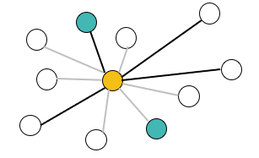
Network Scale-Up Method (NSUM)
The NSUM collects data on abortion using complete social networks, representing both strong and weak ties
Social tied definition
  How many women do you know by name (and they know you by name) who you had contact with in the last 12 months?
Next, respondents are asked to report the total number of women they know who have had an abortion, regardless of tie strength
Notes:
Alternatively, the NSUM collects data on abortion using complete social-networks, representing both strong and weak ties.
To measure network size, The NSUM assumes that women will not be able to accurately list network members. Instead, it uses another approach that I will explain in a minute to estimate the number of women in a respondent’s social network.
Next respondents are asked to report the total number of women they know who have had an abortion, regardless of tie strength
Our research has shown promising results for this method ability to generate appropriate surrogate samples
However, it is unknown whether detailed information on abortions can be accurately measured among weak-ties in the same way as with strong ties

Slide 40
Network Scale-Up Method (NSUM)
What we want to know
What we measure
The population (women aged 15-49)
Respondent’s social network
Social network size = 10
Number of abortions = 2
Abortion Incidence = 20%
Notes:
Alternatively, the NSUM collects data on abortion using complete social-networks, representing both strong and weak ties.
To measure network size, The NSUM assumes that women will not be able to accurately list network members. Instead, it uses another approach that I will explain in a minute to estimate the number of women in a respondent’s social network.
Next respondents are asked to report the total number of women they know who have had an abortion, regardless of tie strength
Our research has shown promising results for this method ability to generate appropriate surrogate samples
However, it is unknown whether detailed information on abortions can be accurately measured among weak-ties in the same way as with strong ties

Slide 41
NSUM: determining social network size
Social tied definition
  How many women do you know by name (and they know you by name) who you had contact with in the last 12 months?
Known population approach
  Each respondent is asked to report the number of people she knows who have a certain characteristic (Ex. How many women do you know who live in a household that owns a camel?)
  Known population sizes from most recent DHS
Notes:
ADD NSUM SLIDES

Slide 42
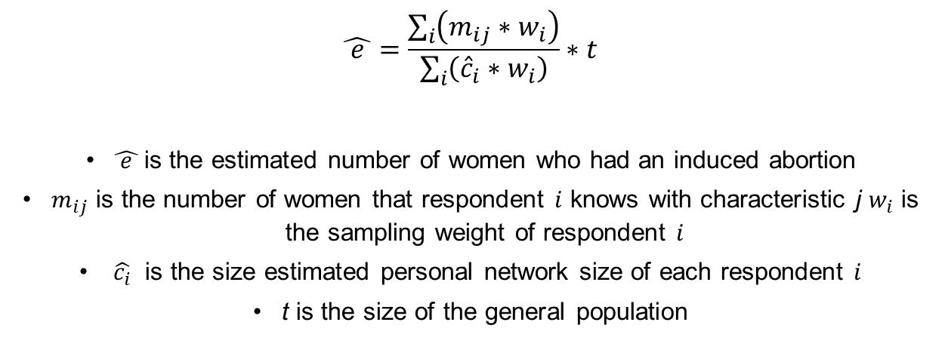
Network scale-up estimate
$$\hat{ e }=\frac{\sum_{i}{\left(m_{ij}∗w_{i}\right)}}{\sum_{i}{\left({\hat{c}}_{i}∗w_{i}\right)}}∗t$$
$\hat{ e }$is the estimated number of women who had an induced abortion
$m_{ij}$ is the number of women that respondent $i$ knows with characteristic j $w_{i}$ is the sampling weight of respondent $i$
$\hat{c_{i}}$ is the size estimated personal network size of each respondent $i$
t is the size of the general population
Notes:
There are two key components to the network scale-up estimate: estimating the size of respondents social networks (c), and then estimating the size of the key population of interest (m), which, in this study, is women who have had an induced abortion. I’m going to discuss in detail how we’ve estimated both of these values.

Slide 43
The denominator: social network size
Known population approach
  Social tied definition: women you know by name (and they know you by name) who you had contact with (in person, by phone, over computer) in the last 12 months
  12 known population questions
    Examples: teacher, smokes, owns a car etc.
    Data: 2016 DHS and WPP 2017
Notes:
To estimate personal network sizes, we use the “known population” approach. Each respondent is asked to report the number of people she knows who have a certain characteristic.
To ask about these known populations, we first have to define who should be counted in a women’s social network, or in other works, our definition of a social tie. In this study, we define a social tie as a women of reproductive age that respondent’s know by site and name, and who know them, who they have contact with in the last 12 months. There are varying definitions of a social tie that NSUM studies have used, but we opted for just women they have had contact with based on feedback during piloting.
We then selected 12 known populations in each country, and asked women how many women they know with those characteristics. In selecting characteristics, two criteria must be met:
the number of individuals in a population that have the characteristic must be known. We use data on characteristics of reproductive age women from the most recent DHS as this was the best available source we could find.
The characteristic must be rare enough that an individual could reasonable count all of the people in her social network with the characteristic. In our analysis we top code response as 30, as other NSUM studies have done, given it’s unlikely respondents can accurately recall exact numbers of people in a known population beyond this number.

Slide 44
Example: Known Population Approach
Question: How many women do you know who live in a household that owns a camel?
Answer: 1
True population size: 529,000 (~1.97%) women aged 15-49
Total population of women 15-49: 26,737,000
Social network size: 1/529,000 * 26,737,000 = 50.5
The more “known population” questions that are asked of each respondent, the more accurate the network size estimate becomes.
Notes:
As an example, in the Ethiopian survey, respondents were asked “how many women do you know who live in a household that owns a camel?” If a respondent reports that she knows 1 women who fits this description, and we know from the most recent Ethiopian Demographic and Health Survey that approximately 529,000 women live in a household that owns a camel, we estimate that the respondent knows 1 out of 529,000 Ethiopians. We can then estimate that the size of her social network is 51 by multiplying 1/529,000 by the total number of women age 15-49 living in Ethiopia (26,737,000). The more “known population” questions that are asked of each respondent, the more accurate the network size estimate becomes.
Talk about challenges in identifying and using known populations.

Slide 45
NSUM: Sampling Considerations
Community-based survey or other representative sample of women of reproductive age
Included as module in pre-existing survey
Need to also collet data on direct reporting of abortions (transmission bias)
  Sufficient sample size in CBS
  Alternate study design (e.g. RDS)
Notes:
Same sampling considerations as the Confidante method

Slide 46
NSUM Pros and Cons
Pros:
Even if respondents do not want to talk about their own abortions, they may be more willing to say if they know anyone who has had an abortion.
Cons:
Little is known about motivations, circumstances, and timing of abortion disclosure between social network members
We can test how well the NSUM is working – rare to have validation of method!
Time-bounding of social tie (12 months) may influence incidence estimates of rare outcomes like abortion
Possible continued underreporting of abortion, even with third-party reporting
Transmission bias higher than with closer social ties
Only get incidence data (testing approaches for detailed information)

Slide 47
Measuring abortion using NSUM and Confidante method
NSUM
  …how many have ever done something to intentionally end a pregnancy?
  …how many have ended a pregnancy in the past 12 months?
Confidante
  …has she ever done something to intentionally end a pregnancy?
  In what year did this last happen?
Notes:
The question used to measure induced abortion in both Uganda and Ethiopia was “Of the women you have had contact with in the past 12 months, how many have ever done something to intentionally end a pregnancy?”, and “Thinking of these X women who you have had contact with in the past 12 months and who have ever ended a pregnancy, how many have ended a pregnancy in the past 12 months?”
In addition, we also use the NSUM method to estimate another reproductive health behavior – the use of IUDs or implants – for which we have a known estimate. Assuming that sharing information on contraceptive use may be similar to how women share information on abortion, we ask about IUD and implant use treating this as a temporarily unknown population.

Slide 48
Visibility of abortion in social networks
We assume that women do not have perfect knowledge of abortions in their social networks
    “transmission bias”
    Likely larger in magnitude for NSUM than Confidante
Calculate visibility of abortion among women who self-report an abortion
    NSUM: How many people [social tie definition] know that you ended this pregnancy?
    Confidante: Did you discuss ending this pregnancy with [confidante name]?
Notes:
One assumption of social network based measures is that all respondents have perfect knowledge about all people in their social network or among their confidantes. (i.e. if someone in your social network has cancer, then you know they have cancer). Violations of this assumption are called “transmission effects”. However, abortions are not likely to be known by everyone in someone’s social network.
Traditionally done through separate RDS study of individuals with study characteristic
Game of Contacts
Currently testing novel approach
Measured among sub-set of women who directly report abortions in the survey

Slide 49
Transmission Bias Adjustment
Adjust NSUM estimate for how visible the hidden population is
Example: on average, 20% of individual’s networks knows they had an abortion
  20% = “visibility factor”
  NSUM estimate: 50,000 women had an induced abortion
  Transmission adjusted NSUM estimate:
    50,000 * (1/0.2) = 250,000 women had an induced abortion
Notes:
For example, if a woman told us she told 5 women in her network about her abortion, and her overall social network size is 25, we’d estimate a visibility of 20%. If the overall visibility factor was 20%, and we had a scale-up estimate of 50,000 women having an induced abortion, then we would multiply the 50,000 abortions by 1/.2 and get an transmission-bias adjusted estimate of 250,000 abortions.

Slide 50
Transmission Bias Adjustment
Notes:
Findings from Ethiopia

Slide 51
Internal validity checks
Treat each known population as unknown
    Back-estimate the population size using same method as for abortion
    See extent to which the back estimates mirror the known population sizes
      The closer the ratio is to 1, the more accurate the estimate
Estimate other well-measured reproductive health behaviors
    NSUM estimate of IUD/Implant use
Notes:
Finally, I want to talk about the validity checks that can be done using the NSUM method.
First, in order to test the relative accuracy of the NSUM estimates, we can treat each known population as if it’s unknown, and then use the NSUM to estimate that population. To test the accuracy of this back estimate, the newly estimated population size is compared to the known number of women with that characteristic. The extent to which the back estimates mirror the known population sizes provides confidence in the relative accuracy in the estimates for the size of the hidden population, in this case induced abortion.
In addition, we also use the NSUM method to estimate another reproductive health behavior – the use of IUDs or implants – for which we have a known estimate. Assuming that sharing information on contraceptive use may be similar to how women share information on abortion, we ask about IUD and implant use treating this as a temporarily unknown population.

Slide 52
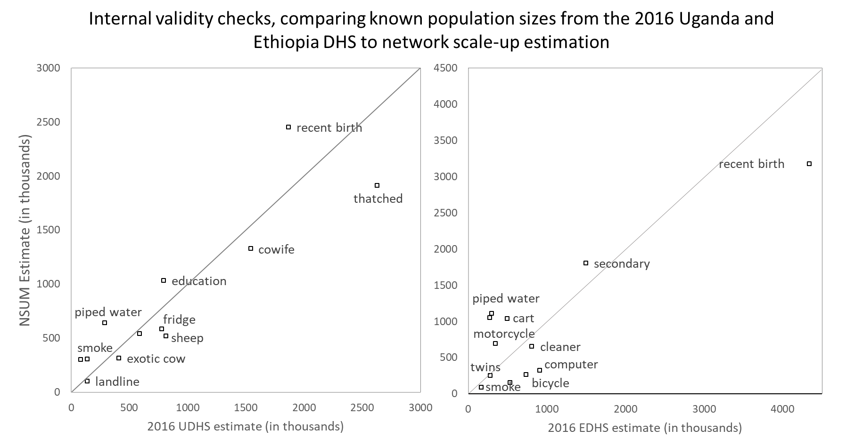
Validation check: NSUM
Overall, the NSUM does a good job of estimating the sizes of populations in Ethiopia, using the data collected in the 2018 FQ.
Notes:
Findings from Ethiopia

Slide 53
Validation check
Estimate IUD/implant use using NSUM and Confidante method
Benefits | Limitations
Reproductive health behavior: information potentially shared among the same ties | Visibility: Transmission bias adjustment still required
Long-acting: less time-dependent as other contraceptive method | Purpose of disclosure: Less of a notable event than abortion

Slide 54
Representativeness: Confidante
Compared limited confidante socio-demographic characteristics to respondents + DHS
  Systematic differences in both countries for age, education, and region
Reweighted confidantes based on these differences
  *May be different in other important ways we could not measure!!
Notes:
Findings from Ethiopia

Slide 55
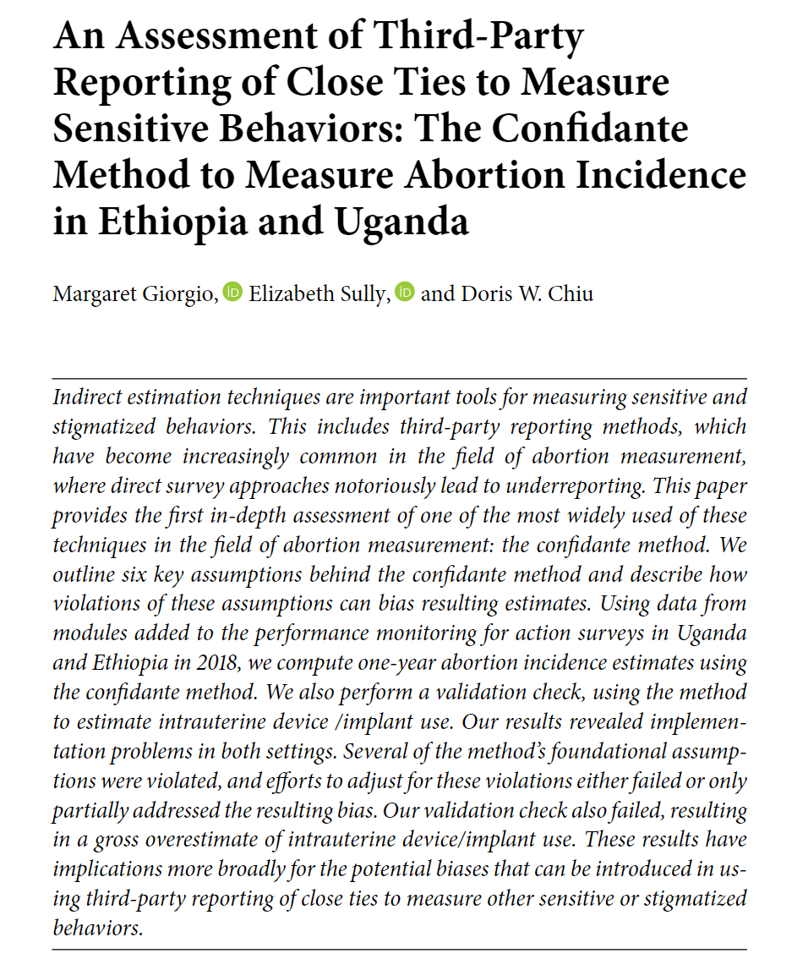
Evidence from Ethiopia: Confidante
Application of the confidante method in Ethiopia in 2018 yielded an abortion rate estimate of 7.1 per 1,000
After adjusting for transmission bias, the confidante abortion rate increased to 18.6 per 1,000
Both the unadjusted and transmission bias-adjusted confidante rates were considerably lower than the 2014 AICM rate for Ethiopia (28.0 per 1,000)

Slide 56
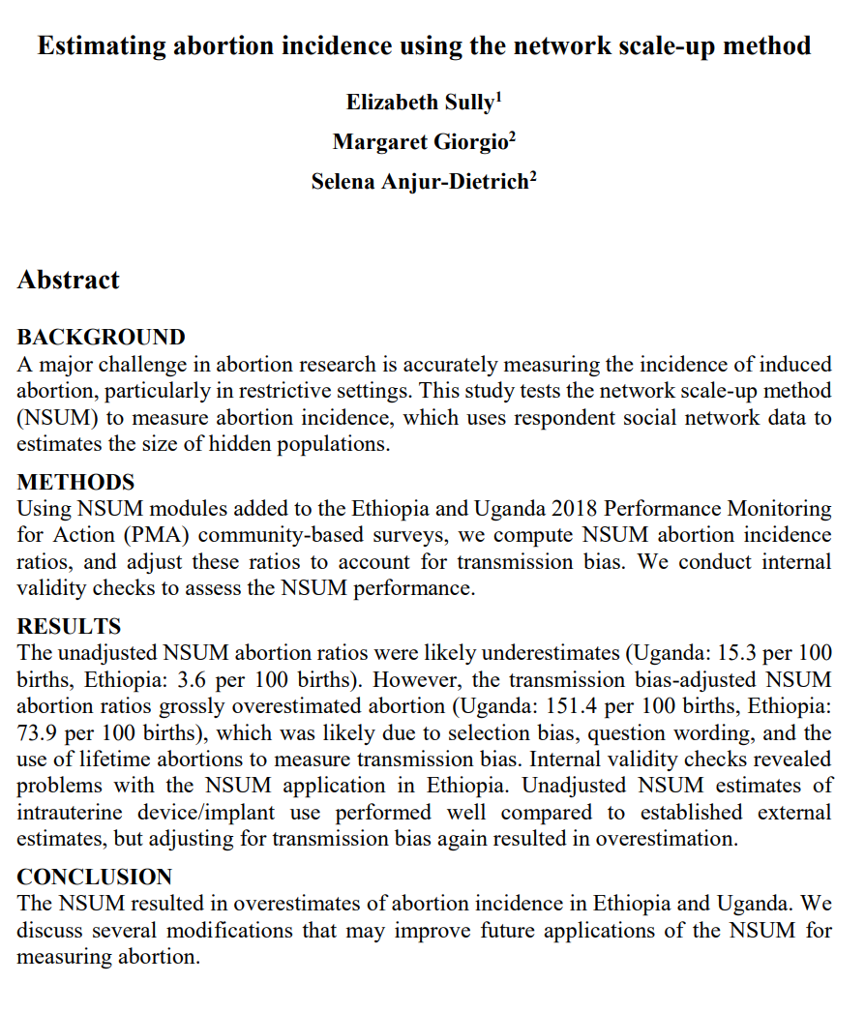
Evidence from Ethiopia: NSUM
Application of the confidante method in Ethiopia in 2018 yielded an abortion rate estimate of 3.6 per 100 births
However, the transmission bias-adjusted NSUM abortion ratios grossly overestimated abortion (73.9 per 100 births)

Slide 57
Abortion Incidence Ethiopia
Notes:
Findings from Ethiopia
NSUM as a potential minimum estimate
Confidante can’t be as it can also be too high – in UG it overestimated abortion

Slide 58
Validation check: IUD/Implant Use

Slide 59
Conclusions
Social-network based methods for measuring hidden populations a promising approach for abortion
But more research is needed on:
  Abortion disclosure happens in social networks
  Transmission bias
  Impact of survey design and interviewer training
  Relevance of other social tie definitions

Slide 60
Other Indirect Methods
Other indirect methods for measuring abortion exist, but none have worked very well at estimating abortion incidence
  Sealed envelope method
  List experiment
Notes:
Don’t learn about characteristic of abortion – only methods that get at incidence
Need to think about how much incidence data valuable without anything else – e.g. methods, complications, safety etc.

Slide 61
Discussion
You just received funding to survey women accessing reproductive health services over a 1-month period in 5 select health facilities in one region in Ethiopia. One of your secondary objectives is to understand abortion incidence in this region. What questions might you consider building into your survey instrument? What limitations might your findings have?

Slide 62
Methods to Study Complications, Quality of Care, and Access

Slide 63
Health Facilities Survey (HFS)
Notes:
20 MINUTES

Slide 64
Health Facilities Survey (HFS)
The best method we have to measure the structural quality of care of safe abortion and post-abortion care
In-person interview with healthcare providers in facilities
Collects information on: Number of PAC cases seen in last month and in average month; PAC treatment provided; PAC contraceptive counseling and services
Notes:
The HFS should be familiar, because we introduced it during the AICM methodology presentation. It is one data collection tool used in the AICM, but can also be used on its own to collect information on complications, quality of care, and access

Slide 65
The HFS and Signal Functions
Importantly, the HFS can be used to measure signal functions for post-abortion care, or in other words the key medical interventions needed to offer safe abortion and post-abortion care, including:
  Capacity to administer certain interventions, like IV fluids, antibiotics and blood transfusions
  Provision of family planning methods
  Staff capable of undertaking normal and cesarian deliveries
  And other interventions
  Measure of structural and process components of quality of care (does not include outcomes) (Donabedian, 1988)
Notes:
Data can be critical to assessing the health system capacity to provide PAC and CAC

Slide 66
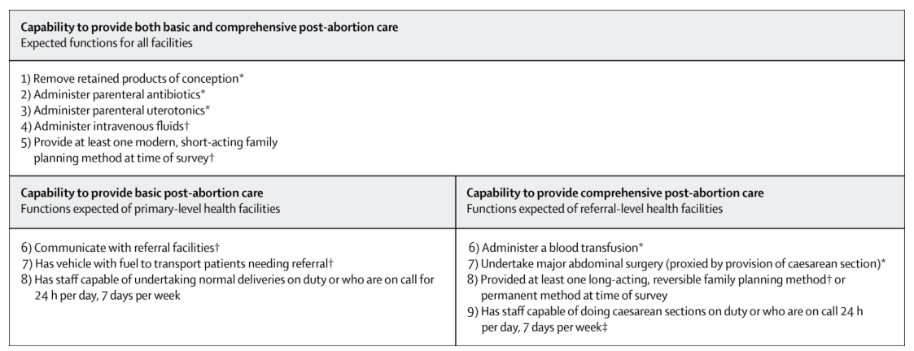
Signal functions for basic and comprehensive post-abortion care
From Owolabi et al (2019). Health systems’ capacity to provide post-abortion care: a multicountry analysis using signal functions
Notes:
Mention Oni cross-country paper
Also in-depth country papers in Zimbabwe, Indonesia
Data coming out soon on Ethiopia – showing quality of care at two points in time for PAC and AC

Slide 67
Capability to provide SAC (and PAC) increased from 2018 to 2020 in Ethiopian public health facilities
Preliminary data – do not cite
Notes:
Overall, but SAC and PAC capability in facilities increased between 2018 to 2020, even though the GGR was in effect over this period .
Other findings related to PAC/SAC capability:
PAC coverage was high (approximately 95% of facilities)
More facilities were better equipped to provide basic and comprehensive SAC services than PAC services (due to PAC signal functions requirement of providing FP every day of the week)
PAC improvements driven by significant increases in medication abortion

Slide 68
Ethiopia: PAC cases decreased over time while CAC cases increased in public facilities
Preliminary data – do not cite
Notes:
There is evidence to suggest that abortion safety increased during the period the gag rule was in effect. The number of safe abortions provided in health facilities increased by almost 10% from 2018 to 2020, and postabortion care cases decreased by 7%.³
Overall, we see that between 2018 to 2020, PAC caseloads were decreasing in the health facilities in our panel, while SAC increased overall.
We all see that PAC decreased at facilities with less capability, and increase a little in facilities that met Basic or comprehensive signal functions for PAC service provision.
For SAC, we see that facilities with basic capabilities were where the increase in caseloads were occurring, suggesting that lower-level facilities are expanding provision and access to safe abortion care over this period.

Slide 69
The HFS can help answer questions such as:
Are health facilities equipped to provide quality abortion care?
How many providers are trained in abortion care, by cadre and procedure?
How many PAC cases are estimated to be treated in this facility? (for use in the AICM)
Notes:
Other data can be answered from HFS - others
Providers knowledge and attitudes towards abortion
Stock-outs of key contraceptive commodities
What other ideas do you have?

Slide 70
HFS Sampling Considerations
Nationally representative
  But may be sub-national if that is what is required
Universe includes all health facilities capable of providing post abortion care (PAC), or comprehensive abortion care (CAC) where relevant.
  All types: public, private, NGO/mission facilities
  All levels: tertiary to primary, as applicable in each country
Sampling options:
  Sample from across each region or sub-regions (i.e. states, districts) in larger countries
  Stratify by residence to ensure that both urban and rural facilities are included

Slide 71
Pros and Cons of the HFS
Pros:
Nationally-representative
Cons:
Increase in availability of medication abortion means more women have abortions outside of facilities and are not captured
Inability to capture women’s experiences around abortion (decision-making processes; experiences of quality of care; etc.)
Self-reported data from providers
Used to assess care being provided at facilities
Findings can help inform improvements to health system and provision of care

Slide 72
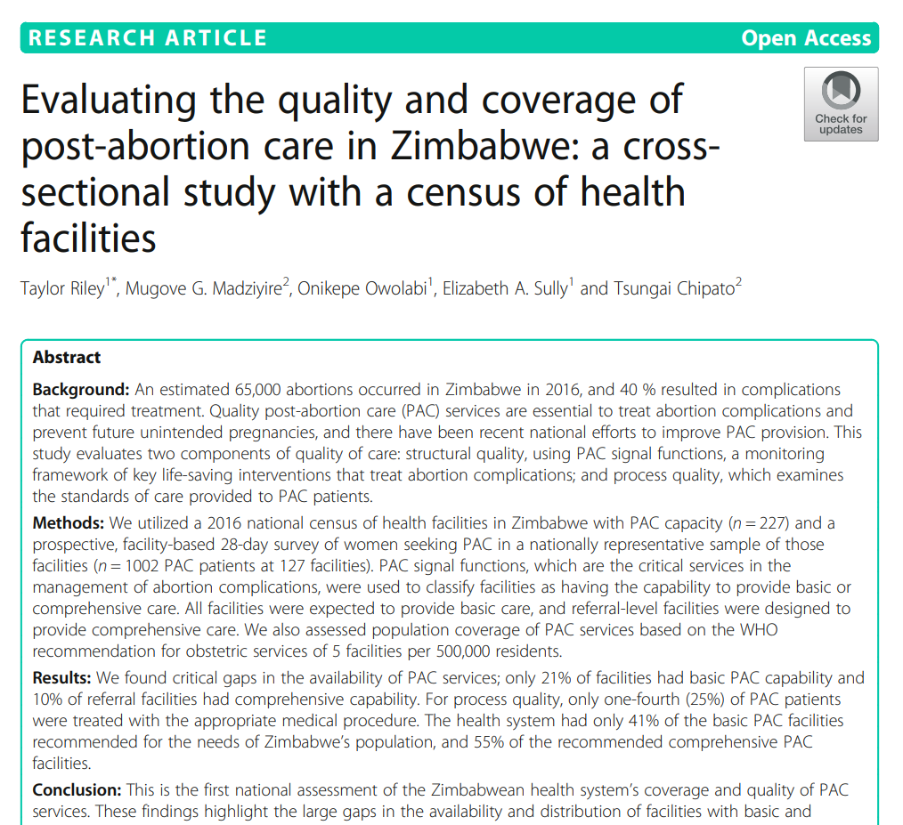
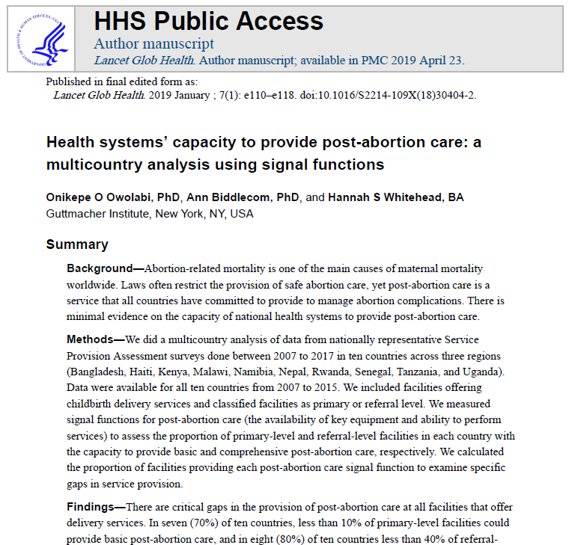
Key Papers for Further Study
Riley T, et al. Evaluating the quality and coverage of post-abortion care in Zimbabwe: a cross-sectional study with a census of health facilities. BMC Health Services Research. 2020;20:244.
Owolabi O, et al. Health systems’ capacity to provide post-abortion care: a multicountry analysis using signal functions. Lancet Global Health. 2019;7(1).

Slide 73
Prospective Morbidity Survey (PMS)
Notes:
30 MINUTES

Slide 74
Prospective Morbidity Survey (PMS)
The PMS consists of structured surveys conducted with consented PAC patients and their providers
The patient PMS collects information on:
Patient characteristics (age, marital status, parity, education, rural/urban)
The provider PMS collects information on:
Abortion-related complications
Delays in care
Quality of care
Treatment provided for abortion complications
Real-time caseload data (as opposed to estimates like in the HFS)

Slide 75

Which women does the PMS capture?
Has complications from abortion; receives care in a facility
PMS data is on these women
Has complications from abortion that go untreated
Has no complications from abortion

Slide 76
PMS Aims and Objectives
To assess the frequency of abortion-related complications
To provide detailed data on the severity of complications
To provide detailed data on the clinical care women receive
To assess the factors associated with varying severity of complications
To explore the experiences of care for women receiving PAC
It can provide data for detailed costing studies

Slide 77
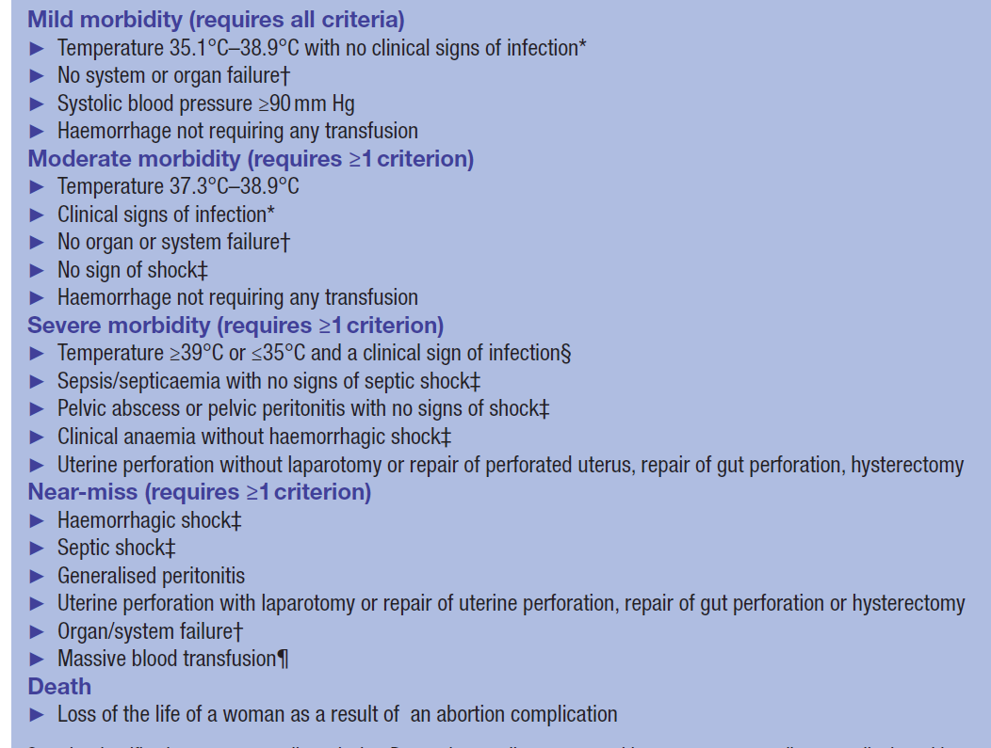
Abortion-Related Complications

Slide 78
Severity Classifications
Severity classifications are mutually exclusive
Women are classified into the highest level of severity for which they met the criteria
There is a need to coordinate with clinicians within the health system to determine the feasibility of using all of these criteria or making reasonable adaptations based on the capacity of the health system, the current content and quality of clinical records, and the burden to clinical data collectors

Slide 79
Prospective Morbidity Survey (PMS)
Inclusion criteria:
Women admitted for abortion-related complications.
    Any hospitalizations resulting from (1) miscarriage/spontaneous or (2) induced abortion including (3) missed, (4) inevitable, (4) incomplete, (5) complete and (6) septic abortion whatever the abortion type (induced or spontaneous) and the severity (up to near-miss and death) at up to 28 weeks of gestation

Slide 80

PMS Case Tracking Form

Slide 81
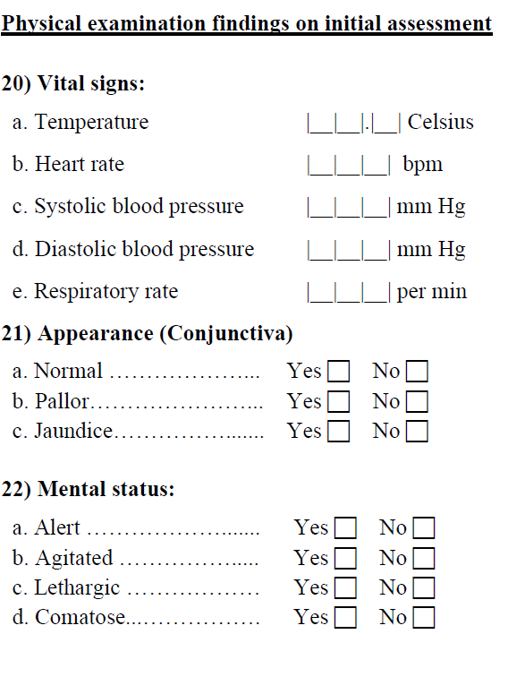
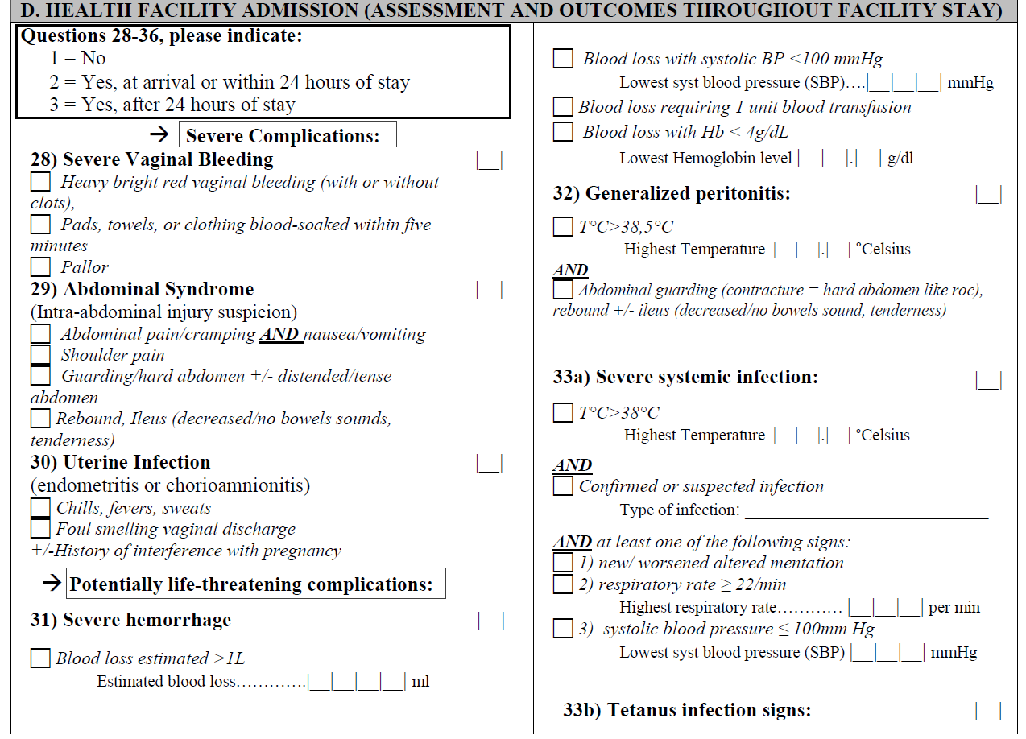
PMS Data Collection

Slide 82
PMS Data Collection: Additional Information Required
Total number of obstetric and gynecological admissions for the duration of data collection
Total number of deliveries and live births for the duration of data collection
Total number of maternal deaths recorded within the hospital HMIS for the duration of data collection
Number of women seen in facility with a diagnosis of abortion (except threatened abortion), who don't have a medical record (patient file).

Slide 83
The PMS can help answer questions such as:
What is the distribution of severe and near-miss abortion complications in this region/country?
What are the factors associated with varying severity of complications?
What are women’s pathways to abortion care? What delays do they experience in accessing abortion care?

Slide 84
PMS Sampling Considerations
Facilities with the capacity to provide post-abortion care (preferably those with enough cases to provide useful data over 28 days)
  In a smaller country or with extensive resources you can use the exact same sample as the HFS accounting for facilities that do not provide post-abortion care in the weights
  In a larger country or with more constrained resources you can take a sample of facilities from the HFS sample.
    Sampling frame- HFS universe
    You can stratify like in HFS- by province and level
    Similar to HFS we typically include all large facilities with most cases, randomly sample smaller ones
Aim to interview all PAC patients and their providers, but very important to track all cases that could not be interviewed or did not consent

Slide 85
PMS Pros and Cons
Pros
Cons
Only captures those people “at the top of the iceberg” (those who experience complications and receive treatment at health facilities)
Nationally representative data on facility-based abortion complications and severity and delays to care
Facility based, meaning information on women with mild complications or severe complications leading to death before arrival at the facility are not captured
Direct interaction with patient receiving care

Slide 86
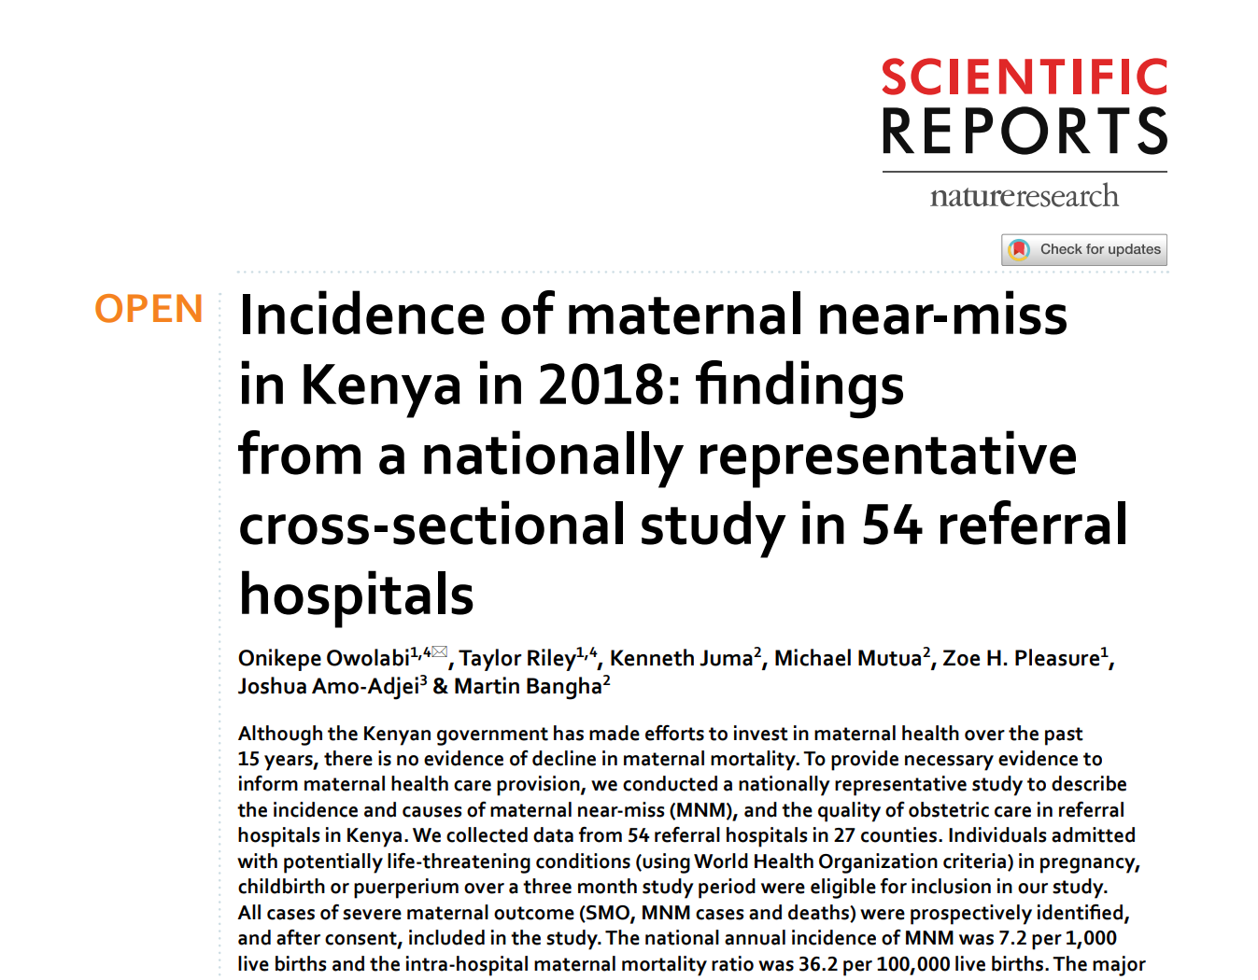

PMS Key Papers for Further Study
Owolabi O, et al. Incidence of maternal near-miss in Kenya in 2018: findings from a nationally representative cross-section study in 54 referral hospitals. Scientific Reports. 2020;10.
Madziyire MG, et al. Severity and management of postabortion complications among women in Zimbabwe, 2016: a cross-sectional study. BMJ Open. 2018;8.

Slide 87
Discussion
Your colleague recently collaborated on an AICM and has PMS data that they would like to analyze. What research questions would you suggest to your colleague that could be answered using PMS data?

Slide 88
Mystery Client Surveys
Notes:
20 MINUTES

Slide 89
Mystery Client Surveys
Mystery clients are trained people who visit or contact facilities/pharmacies/other locations of interest in the assumed role of clients. They often have a series of questions they are required to ask. At the end, they report back on their experience (either through a survey or an interview)
In abortion research, mystery clients have been used:
  To visit pharmacies and assess availability of medication abortion and pharmacist behavior and knowledge in Zambia¹
  To call online abortion medication sellers in Indonesia and attempt to purchase misoprostol²
  To contact abortion facilities in Texas to inquire about facility closure and wait times³
¹ Hendrickson C, et al. Client–pharmacy worker interactions regarding medical abortion in Zambia in 2009 and 2011. International Journal of Gynecology & Obstetrics. 2016;132(2):214-218
² Moore AM, et al. Online Abortion Drug Sales in Indonesia: A Quality of Care Assessment. Studies in Family Planning. 2020;51(4):295-308
³ White K, et al. Change in Second-Trimester Abortion After Implementation of a Restrictive State Law. Obstetrics & Gynecology. 2019;133(4):771-779

Slide 90
Mystery Client Surveys can help us answer questions such as:
How do providers/pharmacists/other populations of interest authentically (without being influenced by the presence of researcher) behave towards abortion clients?
What pharmacies provide quality care and information to people seeking a medication abortion?
Is behavior towards abortion clients related to certain characteristics of interest, such as gestational age or the pregnant person’s age?

Slide 91
Sampling Considerations for Mystery Client Surveys
Listing exercise to understand universe (of pharmacies/online sellers/clinics/etc.) from which you wish to sample
  List can be further refined or divided by any characteristics of interest (ie. government-run/public/chain/urban, etc.)
Random sampling of universe

Slide 92
Mystery Client Survey Pros and Cons
Pros
Cons
Typically small sample sizes
An opportunity to get at “true” behavior of people and places where abortion care may be offered
Certain characteristics (like education or position of the staff member interviewed) may be unknown to the mystery client and to the researchers

Slide 93

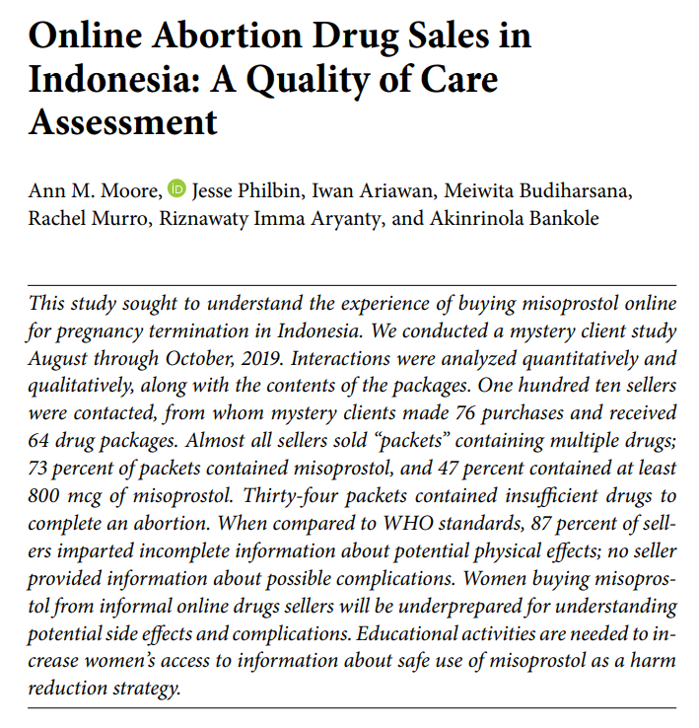
Mystery Client Key Papers for Further Study
Moore AM, et al. What does informal access to misoprostol in Colombia look like? A mystery client methodology in Bogotá and the Coffee Axis. BMJ Sexual and Reproductive Health. 2020.
Moore AM, et al. Online Abortion Drug Sales in Indonesia: A Quality of Care Assessment. Studies in Family Planning. 2020;51(4):295-308

Slide 94
Client Exit Interviews (CEIs)
Notes:
20 MINUTES

Slide 95
Client Exit Interviews (CEIs)
Client exit interviews are surveys administered to people receiving abortion care after their service. They are similar to the patient PMS in that they are administered directly to abortion clients
They are very focused on quality of care, and are often used by facilities and NGOs with the aim of improving abortion care
  They can also be used to collect information on the demographics of abortion clients and abortion caseloads

Slide 96
CEIs can help answer questions such as:
How do abortion clients assess the quality of care they received?
What are the characteristics of people seeking abortion care, and how to they differ by types of facilities/regions/other characteristics of interest?
Are abortion clients satisfied with their care?

Slide 97
Sampling Considerations for CEIs
Often conducted to evaluate services provided at certain facilities of interest
  Random sampling or sampling 100% of facilities of interest, depending on resources available
Target sample size calculated based on caseloads
  May require fewer days of data collection at larger facilities and more days of data collection at smaller facilities

Slide 98
CEI Pros and Cons
Pros
Cons
Often not nationally representative, nor generalizable at a country or regional level
Flexible tool that allows researchers to capture different measures of abortion care
Quality of abortion care is difficult to measure, and researchers must be thoughtful about the questions used (resources do exist on measurement of abortion quality)
Social desirability bias may mean results skew towards positive feedback
Direct interaction with patient receiving abortion care

Slide 99
Methods to Study Abortion Experiences and Stigma
Notes:
Here representativeness of the sample may be less important, and we may be specifically interested in a deeper understanding of experiences of people who have had abortions, or to assess perspectives on abortion among a certain population of interest.

Slide 100
Abortion Experiences & Trajectories
“Abortion experiences” encompass a wide range of research topics, including but not limited to:
  Awareness of pregnancy
  Decisions around disclosure of abortion, including reasons for disclosure and emotions around disclosure
  Social and emotional support for/against abortion
  Access to abortion providers or methods
  Reasons for choosing abortion, including ambivalence or uncertainty
  Perceived or experienced outcomes from abortion or attempted abortion
  Beliefs about morality of abortion
  Partner/family/community contexts
  Access to/availability of abortion information
Notes:
To study abortion experiences, we need to speak with people who have had abortions. But how to find them?

Slide 101
Sampling Considerations for Studying Abortion Experiences
Notes:
10 MINUTES
When we talk about wanting to conduct research among people who have had abortions, a big question here is how do we find women who have had an abortion (both for qualitative & quantitative research)

Slide 102
How to find women who have had an abortion
This is particularly difficult because many women do not want to tell people that they have had an abortion due to stigma, legal concerns, etc.
This has been reaffirmed in recent studies from the US that have found that abortion self-reports are unreliable (meaning we can’t simply ask people if they’ve had an abortion, and self-reported data on abortion within research studies must be interpreted with caution
People who have had an abortion are thus difficult for researchers to identify & recruit for study participation, making sampling issues for studies specifically aimed at recruiting people who have had an abortion particularly important to consider

Slide 103
How to find women who have had an abortion
Facility/location-based sampling
Going to a location where women obtain abortions and asking them to participate in your research
Either immediately before/after the abortion (as done in the PMS and CEIs)
Or by establishing a location & later date to conduct the research
Social network referral sampling, like respondent-driven sampling (RDS)
Designed to reach into social networks and provides access to hidden populations for which no sampling frame exists
“Seeds” are asked to recruit members of their social networks to participate in the study
In the case of abortion, asked to recruit peers known to have an abortion within the past 6 years
Community-based surveys
Integrating questions about abortion experiences into community-based surveys

Slide 104
Abortion Safety
Notes:
10 MINUTES

Slide 105
Abortion Safety
As we know, many people have abortions outside of facilities/clinics for a number of reasons
  Raises the question: how to measure abortion safety outside of clinic settings?
  Particularly important given the wide availability and use of misoprostol for self-managed abortion
How to measure abortion safety?
  Method used
  Presence of a trained provider / accompaniment
We can build in questions about abortion safety in:
  Community-based surveys
  Studies using RDS or social network methods
Limitation is that data is self-reported
Notes:
As we know, many people have abortions outside of facilities/clinics for a number of reasons, including:
Legal restrictions
Stigma
Fear of mistreatment
Preference for other treatment modalities

Slide 106
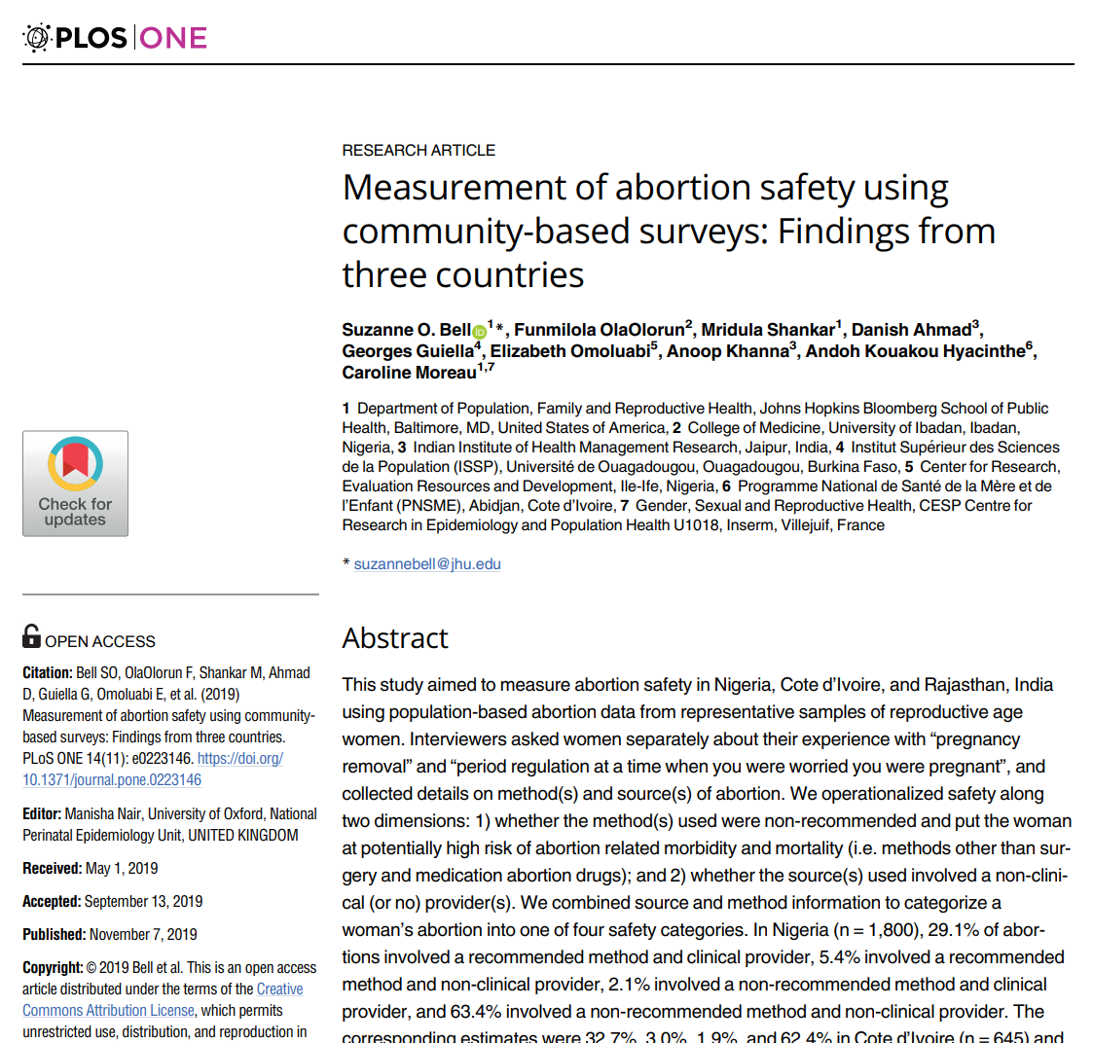
Abortion Safety in Community-based surveys
Bell SO, et al. Measurement of abortion safety using community-based surveys: Findings from three countries. Plos One. 2019;14(11).

Slide 107
Abortion Stigma
Notes:
30 MINUTES

Slide 108
Measuring Abortion Stigma
We know abortion is highly stigmatized around the world; measuring abortion stigma is an important part of understanding the abortion experience
A number of validated scales exist to measure abortion stigma
These scales can be incorporated into other surveys or used as a standalone survey to understand abortion stigma among:
  Community members
  Women who have had an abortion
  Providers

Slide 109
Community Stigma Scales
These scales measure the level of abortion stigma that exists at the community level
Consist of a series of statements that respondents are asked whether they agree with (5-item Likert scale from strongly disagree to strongly agree)
Two well-tested & validated scales exist:
  Stigmatizing Attitudes and Beliefs Scale (SABAS)¹
    18-item scale
  Community Level Abortion Stigma Scale (CLASS) ²
    23-item scale
¹ Shellenberg KM, et al. Developing a Scale to Measure Stigmatizing Attitudes and Beliefs About Women Who Have Abortions: Results from Ghana and Zambia (2014). Women & Health; 54:599-616
² Sorhaindo AK, et al. Constructing a validated scale to measure community-level abortion stigma in Mexico (2016). Contraception; 93:421-431

Slide 110
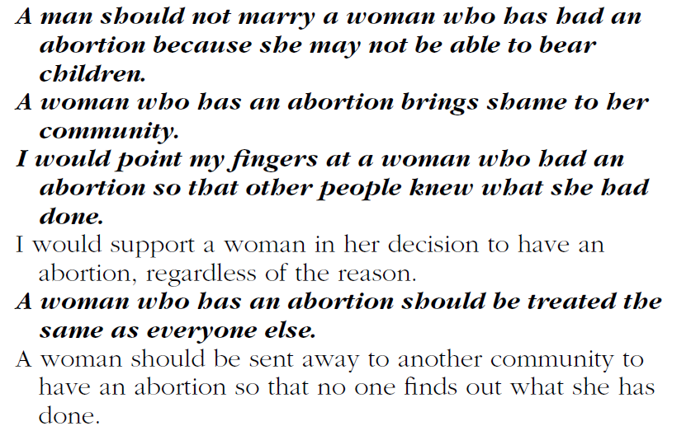

Example items from SABAS
Example items from CLASS

Slide 111
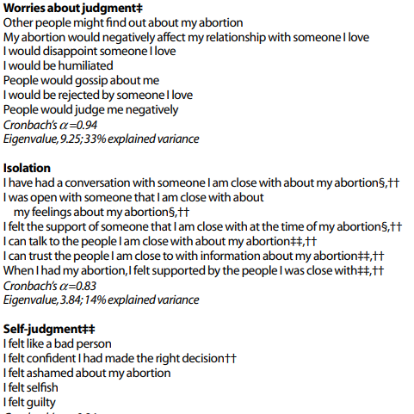
Individual Level Abortion Stigma Scale (ILAS)
To be used among women who have had an abortion
20-item scale
Scale includes statements about worries about judgement, isolation, judgment, and community condemnation
Cockrill et al. The Stigma of Having an Abortion: Development of a Scale and Characteristics of Women Experiencing Abortion Stigma (2013). Perspectives on Sexual and Reproductive Health; 45(2):79-88.

Slide 112
Abortion Provider Stigma Scale (APSS)
To be used among abortion providers
35-item scale
Scale includes statements about experiences of workplace, community, and family stigma
Martin LA, et al. Evaluation of Abortion Stigma in the Workforce: Development of the Revised Abortion Providers Stigma Scale (2017). Reproductive Health; 28(1):59-67
Notes:
While not applied among people who have had abortions, this is another abortion stigma scale that exists specific to abortion providers

Slide 113
Qualitative Methods
Notes:
Qualitative methods lend themselves to more “in-depth” analyses about abortion experiences & trajectories
30 MINUTES

Slide 114
Qualitative Methods
Are useful when:
The question is “how” or “why” and not “how many,” including the details and dynamics of events rather than quantification
The subject matter of interest is sensitive
When the researcher desires to use open-ended questions to gather more descriptive data
When very little is known about a subject and thus requires exploration

Slide 115
Types of Qualitative Data
Observation - Semi-Structured and Unstructured
Field Notes - Detailed descriptions of contexts and/or interventions
Interviews - Semi-structured and in-depth interviews
Focus Group Discussions
Surveys - Open ended questions and written comments from questionnaires
Document analysis
Notes:
There are many different types of qualitative data; here we’ll be focusing on two of the most commonly used ones in abortion research: focus group discussions and in-depth interviews

Slide 116
In-depth Interviews (IDIs)
One-on-one interviews
Discursive and allow the researcher and respondent to explore an issue
Used to determine individuals' perceptions, opinions, facts and forecasts through detailed open-ended responses to questions
Interview guides are typically structured in a way such that the first questions help to build rapport between the interviewee and the interviewer, followed by key questions needed to answer the research questions. Often the interview guide contains probing questions to ensure richness of data
Require trained interviewers for highest quality data
Discussions are often tape-recorded (with interviewee consent) and transcribed for analysis

Slide 117
Focus Group Discussions (FGDs)
A type of interview in which selected participants meet in small groups to discuss a specific topic (often between 6 and 12 participants)
Usually, participants in the same group often share some characteristic of interest to the research (adolescents; doctors; people who have an abortion)
If it is believed that certain characteristics may influence results or willingness to speak on an issue, groups can be divided based on these characteristics (ie. age, gender)
Usually, multiple FGDs are needed to ensure good coverage
Require a very skilled moderator to keep the conversation focused and a note-taker. Discussions are often tape-recorded (with participant consent) and transcribed for analysis
Notes:
Smaller group discussions are also an option in qualitative research, including dyadic and triad interviews

Slide 118
IDIs vs. FGDs
IDIs
Questions are focused on the individual experience
Useful for individual level information
FGDs
Questions are less focused on the individual experience and more about the group or community they belong to
Useful for group/community level information
Better for highly sensitive information that researchers don’t believe would be readily shared in a group
Yields a lot of information in a relatively short amount of time
Oftentimes, researchers employ both FGDs and IDIs to gather group-level data and to dig deeper into certain areas of interest with IDIs
Notes:
Smaller group discussions are also an option in qualitative research, including dyadic and triad interviews

Slide 119
Sampling Considerations for Qualitative Research
Certain sampling methods are commonly used in qualitative research
  Purposive sampling
  Convenience sampling
  Social network referral methods like respondent-driven sampling and snowball sampling
Sampling until saturation
  Saturation is the point at which you’re no longer hearing new information relevant to the research question (ie. the point at which data becomes redundant)
Because qualitative research sample sizes are typically smaller than those obtained for quantitative research, findings from qualitative research are less generalizable
  Researchers must be careful what conclusions they can make about other populations based on qualitative findings

Slide 120
Pros and Cons of Qualitative Research
Pros
Cons
Not generalizable
Allows us to explore certain topics in more detail
Richness of data
Time consuming
Smaller sample sizes

Slide 121
Discussion
You are interested in understanding the experiences of women using medication abortion to terminate a pregnancy outside of the clinic setting. What study methodology would you propose? How would you propose recruiting people for your study, and what might be the limitations of that recruitment method?

Slide 122
Issues to Consider in Abortion Research
Notes:
Given the sensitivity & stigma surrounding abortion, we as abortion researchers have responsibilities to uphold
20 MINUTES

Slide 123
Issues to Consider in Abortion Research:
Ethical and legal concerns
How do we protect research participants? (especially when we are asking them to disclose information about their experiences with abortion, which is highly stigmatized and often criminalized)
Importance of confidentiality
Importance of ethical review of all abortion research
What are the risks of our research on participants? Is it worth it?
How can we ensure research serves those who participate?
Weigh the benefit of our research against risks to research participants
Community-led research
Consider research participants & communities in dissemination

Slide 124
Issues to Consider in Abortion Research:
Stigma
Is our research or are our research questions stigmatizing? Do they further isolate and stigmatize people who have had abortions?
Ensuring data collectors, interviewers, researchers are well-trained and create a non-judgmental, non-stigmatizing environment for research participants

Slide 125
Issues to Consider in Abortion Research:
Interviewer Effects
Be critical about how interviewers may be influencing responses, and try to mitigate that impact
No matter how good the interviewer, people may just not be honest about their abortions, their feelings about people who have abortions, services provided to people who have abortions, etc.
Need to explore different and innovative methods for collecting this information

Slide 126
Issues to Consider in Abortion Research:
Political concerns and backlash
Are we, as abortion researchers, at risk of experiencing political backlash or backlash at the workplace? Are we at risk of violence or stigma for our work in abortion research?
Consider your own safety and wellbeing
Connecting with other abortion researchers can help to mitigate isolation, stigma, and burnout
How might different audiences respond to our research (pro- and anti-choice groups; policymakers, government, society-at-large, other researchers)?
Consider how our research may be interpreted, and guard against misinterpretation

Slide 127
Issues to Consider in Abortion Research:
Rigor
Abortion research is incredibly sensitive, and is often closely scrutinized by anti-choice individuals and groups
It is our responsibility to ensure we conduct research with the utmost rigor, to ensure that our research can be trusted, that it stands up to scrutiny, that we are not harming research participants, and that it doesn’t serve to further restrict abortion access or stigmatize people who have abortions

Slide 128
Brainstorm
Revisit the research question and methodology you came up with at the beginning of the day today. After what you have learned today, what changes might you make to your research question and/or methodology?

