Slide 1
Digital Advocacy
Knowledge over hearsay

Slide 2
Introductions Name: Organization: Favorite cold day meal

Slide 3
Expectations

Slide 4
Topics to be covered
Basics of Advocacy
Use of Social Media
Message Development
Campaign Creation
Tackling Fake News
Measuring Success

Slide 5
Sexual Reproductive Health
1. Do young women have unhindered access to information and services to safe abortion in your community?
2. Do you see needs for providing information about safe abortion in your communities? (explain)
3. How can we ensure the right messages about abortion and family planning get to the young people in our community?

Slide 6
Basics Concepts
Behavioral Change
Advocacy
Activism

Slide 7
Advocacy
An activity by an individual or a group which aims to influence decisions within systems (social or institutional)
Voicing our concerns towards a certain goal, be it a change, development or betterment of an issue, representing a larger group
Different from activism because we work from within the system and not calling for change as an outsider

Slide 8
Advocacy Vs. Activism
Definition
Activism is the use of direct, often confrontational action in opposition to or support of a cause.
Advocacy is the act or process of supporting a cause or proposal
System
Activism may involve working outside the system.
Advocacy may involve working within the system.
Connotations
Activism is associated with radical, direct and confrontational actions.
Advocacy is associated with official and less confrontational actions.

Slide 9
Advocacy Vs. Activism
Activities
Activism may involve activities like boycotts, strikes, rallies, street marches, etc.
Advocacy involves public speaking, petitions, conducting and publishing research, media campaigns, etc.
Person Involved
An activist is a person who is engaged in activism.
An advocate is a person who is engaged in advocacy.

Slide 10
Behavioral Change
Long term
Result of Advocacy and other interventions
Individuals, communities and social groups

Slide 11
Why Digital Advocacy?

Slide 12
We advocate a cause or issue because we want to:
• build support for that cause or issue;
• influence others to support it; or
• try to influence or change legislation that affects it.

Slide 13
Why go Digital?
Wider Reach
Accessible
More tools
Cheaper
Quick
Local, regional, national or international reach
Collective Voice
Movement Building
Attention to our issue

Slide 14
Who can be an advocate?
Important:
Be well-informed on the issue
Get data from reliable sources.
EVERYONE!!

Slide 15
Advocacy Tactics
Exercise
Please share any online advocacy tactics you have previously used in your work

Slide 16
Digital Advocacy Tactics
Consistent Content
Preparation ahead of time
Sharing among members
Documenting in-person advocacy sessions
Learning from the campaigns
Joining existing advocacy efforts (local, national, international)
Using hashtags, having a theme,
Images, photos, animation, videos
Sharing results, updates on activities
Contextualized, relatable content
Have a call to action -- an ASK
Working as a coalition to align on messaging
Being ready with quick responses: e.g., when decisions are being made, to have prepared responses for multiple outcomes.

Slide 17
Identify the issue

Slide 18
GROUP WORK
What are the issues that YOU would like to tackle digitally in relation to access to safe abortion?

Slide 19
Identify the decision maker
Who has the power to help ensure that your issue is addressed?

Slide 20
Issues

Slide 21
Follow up: Which social media platforms are the decision-makers active on?
Identifying Platforms

Slide 22
Decision Makers
We want to identify the appropriate person who has authority to decide.
You may need to persuade more than one person or the leadership of a governing body.
Don’t assume there is only one decision maker.
He/she may not be at the highest level.
Don’t hesitate to take a break to find out more about the decision-making process or take note of what else you need to know about a decision-maker or the process.

Slide 23
Social Media: Useful or Harmful Debate

Slide 24
Activity
Google your name

Slide 25
Day 2 Recap

Slide 26
Use of Social Media
Helps reach thousands if not millions of people at a time
Free flow of information
A lot of time is spent on it
It is convenient
Builds relationships
Increases visibility
Access to people or organizations that you wouldn’t have had in person

Slide 27
Economic Aspects
There are economic aspects to social media platforms.
They can be platforms for the advertisement and promotion of services, products and businesses
Social Media “influencers” with a certain number of followers can get paid to feature content on their platforms
Personal promotion of individuals is also plausible

Slide 28
Why use social media for SRH information and advocacy?
Free flow of information that people would be shy or afraid to talk about in-person
We can post credible and relevant information instead of the misinformation that is common for the subject
It can open up room for questions and answers between a professional and a curious adolescent (e.g., Twitter chat)
Takes information to where most people, especially the youth, are already spending much of their time (e.g., Facebook)
Creates demand for services (e.g., Facebook, Instagram)
Allows for us to share where Youth Friendly SRH Services would be readily available

Slide 29
Political Aspects
Political leaders can use social media as a means of addressing their followers
Helps political parties to promote their goals and action plans
Live transmission of discussions plausible now, especially when attending debates in-person is difficult

Slide 30
Type of social media platforms
Name some of the social media platforms you know
Name some of the social media platforms you use

Slide 31
Most common platforms in Ethiopia

Slide 32
Open the platforms as they come up

Slide 33
Facebook

Slide 34
Facebook
Friendships to catch up on
Promotion of businesses
No word limit for descriptions
Supports images, stories, videos, gifs
Allows for paid promotion of posts
Scheduling of posts
Page, account, groups (open, closed or secret) and marketplace
Advocacy and Activism

Slide 35
Telegram

Slide 36
Telegram
Chat App
Supports images, videos, files, gifs, stickers, voice chat
Scheduled texts and voice message
Groups >100,000 people
Existing bots or create customized ones
Channels
News, updates, business promotion, emotional venting and more

Slide 37
Telegram Channels and Groups
Channels
No subscriber limit
Free to use
Hidden Subscriber list
Used to broadcast
Groups
Personal-level interactions
Polls are available
Bots can manage
Everyone can chat and transfer files

Slide 38
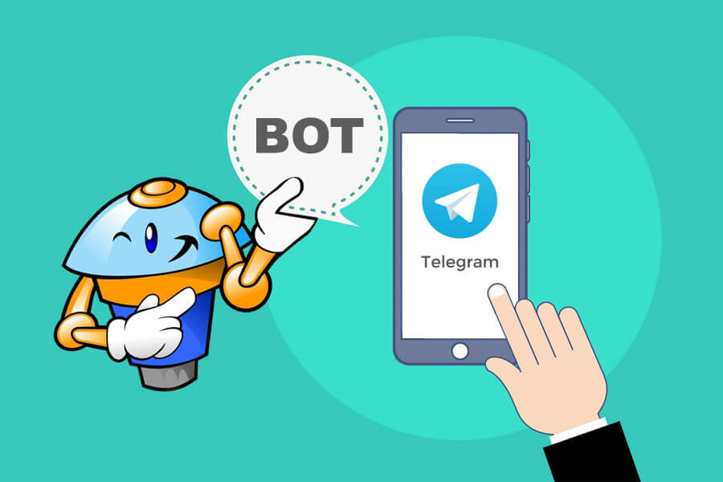
Bots
Bot is a type of “automated user” that can help users filter content in a group or channel and direct them to the relevant contact or place.
Bots are simply Telegram accounts operated by software – not people – and they'll often have AI features. They can do anything – teach, play, search, broadcast, remind, connect, integrate with other services, or even pass commands to the Internet of Things
Telegram is one of the first application to integrate bots into the interface and since then the use of bots only increases.

Slide 39
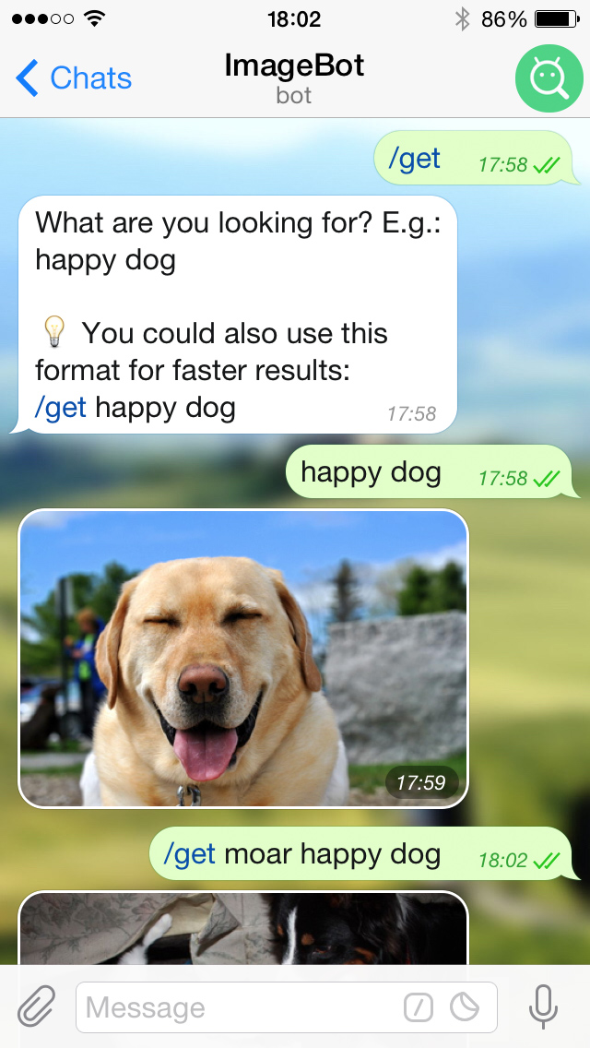

Slide 40
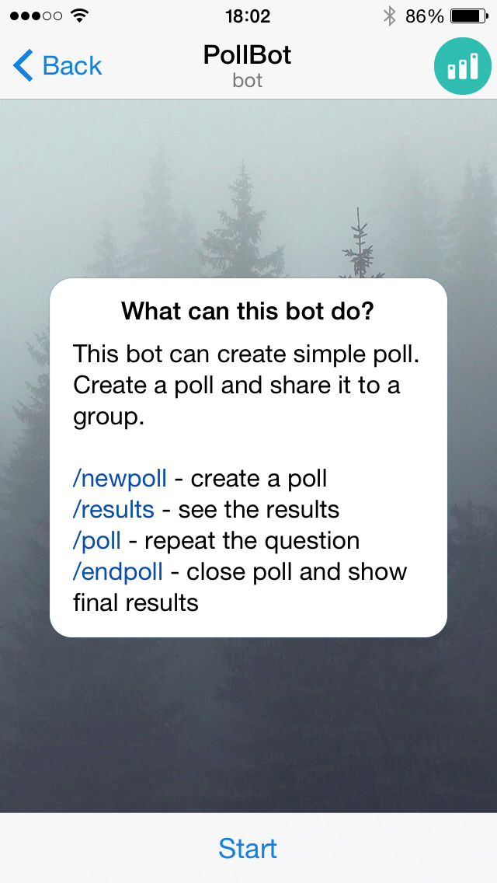

Slide 41
Twitter

Slide 42
Twitter
Each tweet has a character limit of 280
Supports images, links, tagging and messaging (of people who follow each other), stories and videos
reach many people quickly through tweets and retweets
follow the work of other experts in your field
build relationships with experts and other followers
Schedule tweets
High utilization of hashtags
Use of threads

Slide 43
Tiktok

Slide 44
Tiktok
Platform for short videos only
Uses audio templates
Creative youth utilize the platform
“For You Page” is the primary timeline
“Tiktok Communities” for specific topics and themes
60 second time limit for videos created on the app

Slide 45
YouTube

Slide 46
YouTube
Video sharing platform
Varying range of timeline, content, and users
Highly utilized by advocates/activists
Young people and adults looking to learn something new opt for YouTube
More than 70 percent of YouTube watch time comes from mobile devices and 90 percent of people say they discover new things on YouTube

Slide 47
LinkedIn

Slide 48
LinkedIn
Jobs
Internship
Professional Networking
Learn new skills
Showcase your professional story

Slide 49
#Hashtags
Hashtags expand your reach outside your network, engage with your followers, open new ways of communicating and increase brand recognition and awareness. Hashtags are a great way for people to search for topics on social networks that have a common theme. They are also used to signpost a conversation topic.
These are often used on Instagram and Twitter but work well on Facebook as well
@Tags
Brings the username directly at your post. For Example, to tag the Federal Ministry of Health or Federal Ministry of Women Children and Youth, @EthiopiaFMoH or @EthiopiaMoWCY

Slide 50
Activity
Google your Organization’s name

Slide 51
Our online Identity
Name: Authenticity Policy
Posts
What you share
Comments
Tags

Slide 52
Public image
1. Upon Googling a Samrawit, we find a post with a picture of her at an anti-abortion rally from about 4 years ago.
Currently Samrawit is a health care provider at a maternity ward
2. Sami shares a post about respecting women and fights against Gender Based Violence. Sami wrote a long poem about the love he has for his mother. One of his friends post a photo of Sami sheltering a little girl from a ray of sunlight
3. Dagem has posts showing his work as an activist against climate change like rallies, big posters and T-shirts. Dagem also is seen drinking a lot of water. Dagem has multiple plastic bottles around him in all of the pictures.

Slide 53
Message Development

Slide 54
Social Media Message Development
Should be specific to the platform
Must have a targeted audience
The voice must be relatable
Lingo should be tailored
Friendly
Informative
FACTS
Short and precise
Language taken into consideration
Follows current trends

Slide 55
Message formulation
Depending on our decision maker
Rational language
Emotional language
Ethical language

Slide 56
Four questions to consider to increase your audience performance
Who are your messages targeted at?
Do you want the audience to interact with your posts?
Should the audience respond to your post? How should they interact with your campaign?
Is there a Call to Action in your message?

Slide 57
Key points to remember:
1. Articulate the problem and the desired actions clearly
2. Emphasize the urgency and high priority of the recommended actions
3. Use simple words
4. Reach your audience’s emotions

Slide 58
Write a Caption for these images

Slide 59
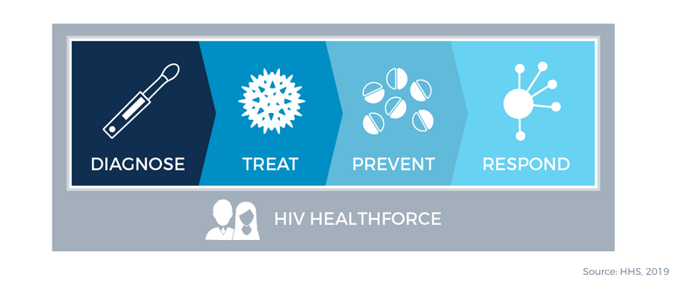

Slide 62
Social Media Campaign
A social media campaign will have to be planned and should target several persons or group of people, or an individual, with a message. The message must be such that it will achieve a predetermined goal.
In this case, the campaign must be on a social media platform to qualify as a social media campaign.

Slide 63
…
Can a Social Media Campaign leverage a physical offline activity or event for success?
Advocacy happens on Social Media when one or more social media users make use of the elements of campaign to influence opinions or decisions of a target audience.
Advocacy on social media will educate, inform, reveal and call attention, for instance, to a behavioral change.
A social media advocate will therefore be a person that uses social media to make a strong case for a thing, a belief, a way of life etc.

Slide 64
Campaign
There are simple basic steps and questions that need to be answered before embarking on a social media campaign.
Do you have a clear picture of what needs to be done and for whom?
Who is the target audience for the campaign, and how we reach them?
Determine what media platform the target audience is using and how to reach them, including other details.
Determine the kind of message that will be appropriate for the target audience
When are these audience active on social media?
Are there other social media users that can reach the audience faster? (e.g., Influencer)

Slide 65
Group Work
Create a post off of the following research document for the platforms our decision makers are active on
(*fact sheet on abortion in Ethiopia*)

Slide 66
Advocacy on the web
(Not necessarily through Social Media)

Slide 67
Public statement
What is the objective of the statement? Is there a solution we are proposing?
Which stakeholders need to review it?
Why is our organization’s perspective important?
What is the main message we want to convey?
What is the distribution mechanism/platform?
Is the issue sensitive?

Slide 68
Policy Briefs
Must inform a decision
State the main argument on top
Develop a positive case for the conclusion
Should be brief, and easy to understand
Make sure to include the evidence

Slide 70
Effective Storytelling
Stories have the power to change the world
Storytelling is a powerful tool in communication and advocacy. The effectiveness of your storytelling determines your ability to captivate the mind and interest of your audience and in the long run, shape the reaction of your audience.
Storytelling works because the human brain is wired to recall narratives and is prepared to encounter it as it's being told.
Aim to craft messages that will convince your audiences to act – rather than messages that simply communicate what you want to say.

Slide 71
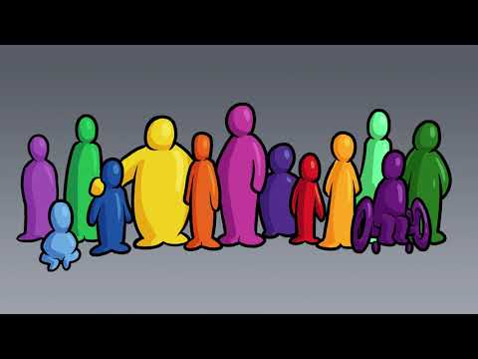
The story of Dalia and Ousman

Slide 72
Group Work
Develop a social media advocacy/campaign (on safe abortion access)

Slide 73
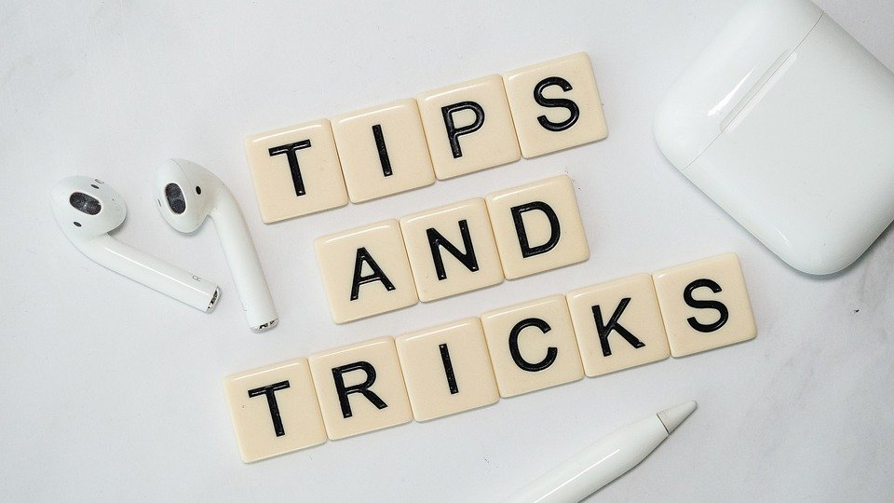
Tips and Tricks…
Pay attention to time and seasons
Consider all other events happening at those times.
You may not want to carry out a Twitter campaign when your audience is focused on the premier league
Consider other trends that could be leveraged. Elections?
Use Hashtags
Use mentions. @ at someone
Pay attention to what might be a national discussion. (e.g., Dire Dawa University and the situation with pregnant students)
Leveraging offline physical activity could produce a great result

Slide 74
…Tips and Tricks
Visuals/Images such as videos and pictures are gain more attention. You can write on the images.
Create custom polls with immediate data tracking information.
Tag other accounts.
Livestream
Pay Attention to Trending Topics

Slide 75
Tips and Tricks
A picture is worth a thousand words
Use clear, high quality pictures
No one wants to spend a long time reading a post. Make it short and precise.
Understand what time your audience is more active during the day
Post regularly
Use local hashtags
Fact check your content
Use graphics, and don’t overcrowd them with texts
Have allies, tag each other
Share content from others (credible source) that is relevant to your topic
Check back with the “insights”
Cite credible sources and tag them

Slide 76
What do we mean by social media abuse
It is defined as the use of technologies such as texting and social networking to bully, harass, stalk or intimidate a person. Often this behavior is a form of verbal and emotional abuse perpetrated online.
Not only are they detrimental for the mental health of an individual, but they can also lead to physical violence such as Gender Based Violence
We need to refrain from sharing our location, especially if we fear for such issues
Be aware that you can block a person and report them on the platform

Slide 77
What do you like from the following posts?
Is there a point of improvement that you’ve noticed?
Which Social Media Platforms are they on?

Slide 78
#GenerationEquality #OrangeTheWorld

Slide 81
“ጊዜው ደርሷል...ሆዴን ይቆርጠኛል፣ ወገቤን ጨምድዶኛል በዛ ላይ ከወትሮው ለየት ብሎ ራሴን አሞኛል። ጓደኛዬ ግራ ቢገባት ኮካ ኮላ ገዝታ "ጠጭበት፣ ይጠቅምሻል" አለችኝ። ከየት ያመጣችው ሳይንስ እንደሆነ እያሠላሠልኩ ብዙም መከራከር ስላልፈለኩ ከመጠጣቱ ጋር ትግል ገባሁ።
አንዱ ጓደኛችን ሲመጣ ግንባሬ ላይ ያለችውን ቀጭን፣ ነጭ ላብ አይቶ ደንገጥ አለ። አጠገቤ ያለውን “Ibuprophen (pain killer)” አይቶ በፍጥነት "ውይ! ምነው? አመመሽ? ምንሽን አሞሽ ነው?" አለኝ። ብዙም አይገባውም ብዬ አስቤ "አይ ባክህ ዝም ብሎ ነው ትንሽ አሞኝ ነው፤ “pain killer” ውጫለሁ አያሳስብም" አልኩት:: እሱ ቀጥሎ "እራስሽን ነው? ምንሽን ነው? ወገብሽን?" አንድ እጄን ሆዴ ላይ፣ አንድ እጄን ወገቤ ላይ አድርጌ ምናልባት ህመሙ ከቀነሰ ብዬ ማሰብ ጀመርኩኝ። ይህን ተመልክቶ ገባው መሰለኝ "እእእእ...ገባኝ ባክሽ፣ አክስትሽ መጥታ ነው አይደል?" አለ። ግራ ተጋብተን "ምን??!!" አልነው። እሱም በእርግጠኝነት መልሶ " ቀዯ አክስትሽ መጥታ አይደል?""
ምናልባት ህመሙ ጭንቅላቴን ደፍኖት ይሆን እኔ ቶሎ አልገባኝም:: ጓደኛዬ ገብቷት ኖሮ ከት ብላ መሳቅ ጀመረች:: ቆይቶ ገባኝ:: "ፔሬድ" ለማለት ፈርቶ ኑሯል ለካስ:: ስለዚህ..."በየወሩ የምትመጣው ቀዯ አክስት" አንድ ቃል ላለማለት አራት ገላጭ መደርደር።
ጉንፋን ሲይዘን ግን ንፍጥን ለመግለፅ "ነጯ ባለነጠላዋ ጎረቤትሽ በቀጭኖቹ መንታ መንገድ መጥታ" አንልም:: "ፔሬድ" ማለት ለምን ያሳቅቀናል?
አንፈርበት!”
በረቂቅ ከተማ

Slide 84
Controlling our News Feed/Front Page
Screen time
Hovering time
Likes
Shares
Comments
Search
Interactions
Google search
Applications privacy setting

Slide 85
Community Standards
Fake names, age
Values: Respect of other’s belief, daily lives (on and offline)
Reporting

Slide 86
Privacy
Know your audience
Review your privacy settings
Do not post sensitive data like ID, medical records, financial data
Review your tags and timelines
See how your profile looks to others

Slide 87
Stay Safe
It is important to know your privacy settings.
Social networks such as Facebook allow the user to control how their information is shared and who has access to it. These are often customizable and are found in the privacy section of the site. Remember, registering for some applications (apps) require you to change your privacy settings.
It is crucial that your passwords are not shared with anyone and if a person makes you uncomfortable online, blocking the individual is always an option
Be aware of the information about you that exists online
Beware of hate speech and inciting of violence

Slide 88
Measuring Success

Slide 89
The use of Analytics Tool
Facebook, Instagram and Twitter have “Insights”
Pinterest, LinkedIn and YouTube have “Analytics”
Numbers!

Slide 90
Why Insights?
It helps us get feedback of what works and does not
Identify followers
Identify new influencers
Follow trends
Optimize campaigns
Develop content, targeting, PR / communication strategy
Find potential allies
Track progress

Slide 91
Reach
Viewers who have SEEN your content

Slide 92
Engagement
Number of people who have interacted with the content
Likes
Comments
Shares

Slide 93
Followers
Number of people who have chosen to like and/follow the page

Slide 94
Create posts with your audience in mind instead of your organization. Think about what your "customers" would find most important and would feel compelled to interact with.
Use social-media specific content and offers that will compel your target audience to follow your accounts.
Incorporate things for your audience to actively engage in, such as polls and questions for them to answer. Engagement deepens your relationship with the audience.
Take time to interact with your followers, reply to comments, like posts they tag you in, etc. Use your own voice, make interactions with followers as authentic as possible. Make them feel like there’s a person on the other end of their conversation.
Increasing Engagement

Slide 95
What is fake news?

Slide 96
Fake News
False, cannot be verified, does not state a source
Misdirecting
Meant to attract a reader
Deliberately inflammatory
Fake news exists within a larger ecosystem of mis- and disinformation
Mis/dis-information

Slide 97
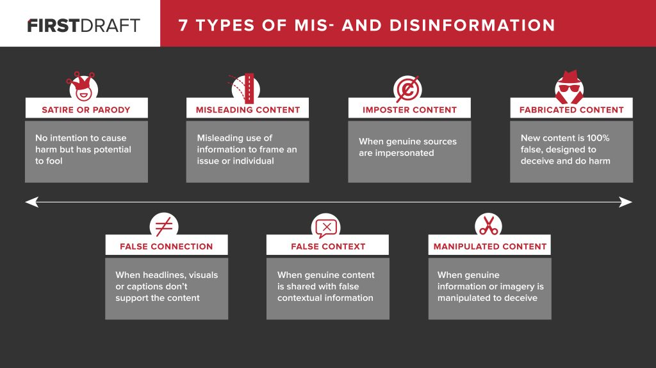

Slide 98
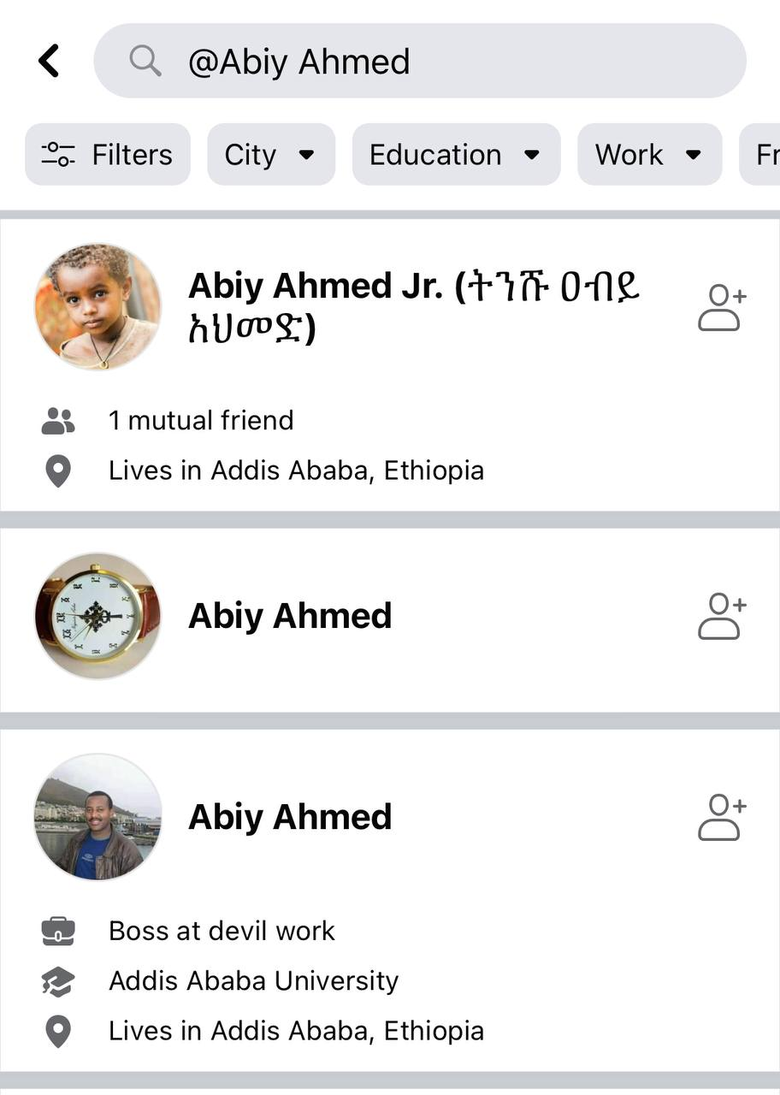

Slide 99
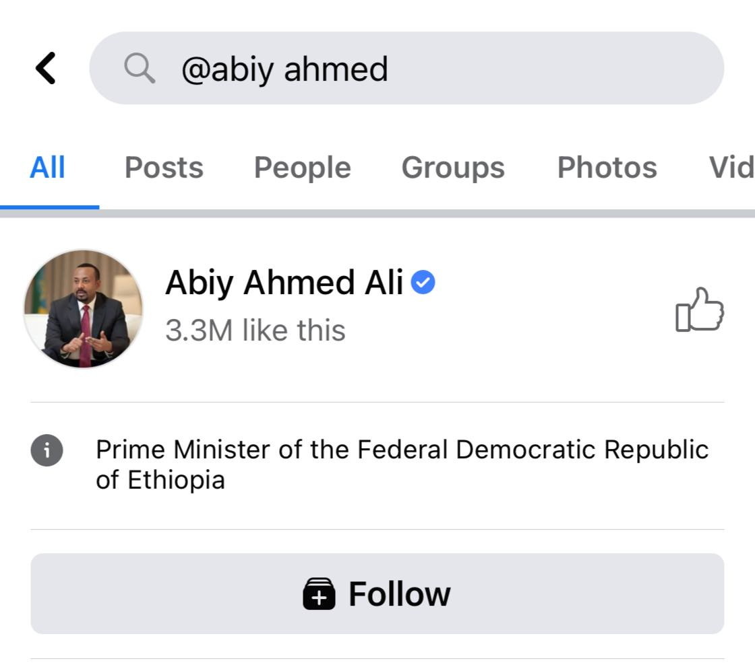

Slide 100
Tackling Fake News
Always ask who the author or publisher is (the source of information)
Check credibility of source
Look for the official handle blue tick
Check the date
Misinterpretation?
Pick your news outlet
Read the whole news and not just captions
Read Widely
Get comfortable with uncertainty
If you haven't read a news article with a critical eye, don't share it. Think twice before reacting or commenting on it.

Slide 101
Misinterpretation
How can you avoid your pictures/content from being misinterpreted?

Slide 102
Fight against Fake news
Pick your words well
Avoid phrases that require tone of voice
Don’t beat around the bush
Be mindful of your audience
Use additional tools (pictures, gifs, memes)

Slide 103
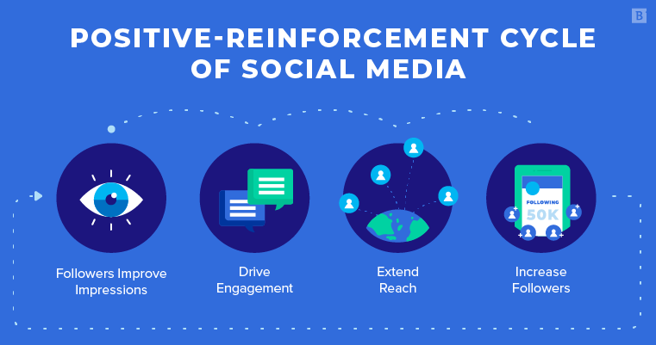

Slide 104
Have fun on Social Media!

