Slide 1
Module: Public Health & Medical Issues in Abortion Research in Nigeria
Name Professor, Address Adesegun Fatusi Academy for Health Development (AHEAD), Ile-Ife, Nigeria & Centre for Adolescent Health & Development, School of Public Health, University of Medical Sciences, Ondo, Nigeria | Name Professor, address Funmilola OlaOlorun Department of Community Medicine, University of Ibadan, Ibadan, Oyo, Nigeria | Name Professor, Address Olabisi Loto Department of Obstetrics & Gynaecology, Faculty of Clinical Sciences. Obafemi Awolowo University, Ile-Ife, Nigeria

Slide 2
Purpose/aim of module
To enable participants to view abortion from the lens of public health and gain knowledge of the key terminologies, concepts, and landscape of abortion in Nigeria to aid research engagements

Slide 3
Learning Objectives
By the end of this module, participants will be able to:
explain the current classifications of abortion by safety
compare and contrast the “cost” of safe and unsafe abortion abortions for population health and the health system
discuss the burden of unsafe abortion globally and nationally
analyse factors associated with the magnitude & cost of unsafe abortion in Nigeria
discuss approaches for the prevention and reduction of unsafe abortion

Slide 4
Introduction
In 1967¹, the World Health Assembly recognized abortion as a “serious public health problem”: More than 50 years after, unsafe abortion remains a global challenge, particularly in low-and-middle-income countries (LMICs)
Abortion is a leading cause of maternal mortality and morbidity in Nigeria & negatively impacts the health & social development landscape significantly: thus, a priority area for more research & action
¹WHO, 1967: 20th WHA resolution 20;14
Notes:
Twentieth world health assembly resolution 20.14: health aspects of population dynamics. Official records of the World Health Organization No. 160; 1967 …
World Health Organization - World Health Organization

Slide 5
Key Components
Abortion: Terminologies and Themes: Definition of abortion, classification of abortions: by intention, including safety (safe vs unsafe, sub-classification of unsafe into “less safe” & “least safe”)
The Abortion Landscape and Scope: International & national
Implications & “Costs” of Unsafe abortion: Health & Health Systems Cost
Pathway to Unsafe Abortion in Nigeria: The underlying and associated factors
Unintended and unwanted pregnancies as the key underlying factors
Poor access to safe abortion care
Addressing the Challenge of Unsafe Abortions: Prevention and control potentials

Slide 6
Abortion: Terminologies & Themes

Slide 7
Abortion: “Types”/Classification
Induced vs. Spontaneous abortion
Complete vs. Incomplete abortion
Medical vs. Surgical abortion
Safe vs. Unsafe abortion

Slide 8
Safe Abortion vs. Unsafe Abortion
Abortion
Safe Abortion
Abortions carried out using a WHO-recommended method appropriate to the pregnancy duration and done by a trained provider
Unsafe Abortion
A procedure of pregnancy termination either by persons lacking the necessary skills or in an environment that does not conform to minimal medical standards or both
Less safe
done by either an untrained person or with a non-recommended method
Least safe
done by an untrained person using a non-recommended method
Ganatra et al, 2017
Notes:
WHO recommended abortion methods (medical abortion, vacuum aspiration, or dilatation and evacuation) that was appropriate to the pregnancy duration
Ganatra B et al., Global, regional, and subregional classification of abortions by safety, 2010–14: estimates from a Bayesian hierarchical model, Lancet, 2017, 390(10110):2372–2381, doi:10.1016/S0140-6736(17)31794-4.
less safe
if only one of the two criteria were
met—ie, either the abortion was done by a trained provider
but with an outdated method (eg, sharp curettage) or a safe
method of abortion (eg, misoprostol) was used but without
adequate information or support from a trained individual
least safe if they were provided
by untrained individuals using dangerous methods, such
as ingestion of caustic substances, insertion of foreign
bodies, or use of traditional concoctions
Safe abortions are those that use a WHO-recommended method appropriate to the pregnancy duration and are done by a trained provider. Less-safe abortions meet only one of these criteria, and least-safe abortions meet neither criterion. Sources: references 2 and 5 (Bankole et al, From unsafe to safe abortion in SSA)

Slide 9
Unsafe abortion has huge cost but preventable
Abortions are generally safe with appropriate method (as recommended by WHO) & appropriately skilled person
Unsafe abortion is a leading cause of maternal morbidity
Unsafe abortion: 4th leading cause of maternal death globally
The risk of dying from an unsafe abortion is highest in Africa
Unsafe abortion has significant costs to the health system
Unsafe abortion is preventable
Notes:
Statement 1: WHO website: Preventing unsafe abortion
Statement 2: Yokoe R, Rowe R, Choudhury SS, et al. Unsafe abortion and abortion-related death among 1.8 million women in India. BMJ Glob Health 2019;4:e001491. doi:10.1136/ bmjgh-2019-001491
Statement 3: WHO & Bankole et al, 2020

Slide 10
The Abortion Landscape & Scope: Global

Slide 11
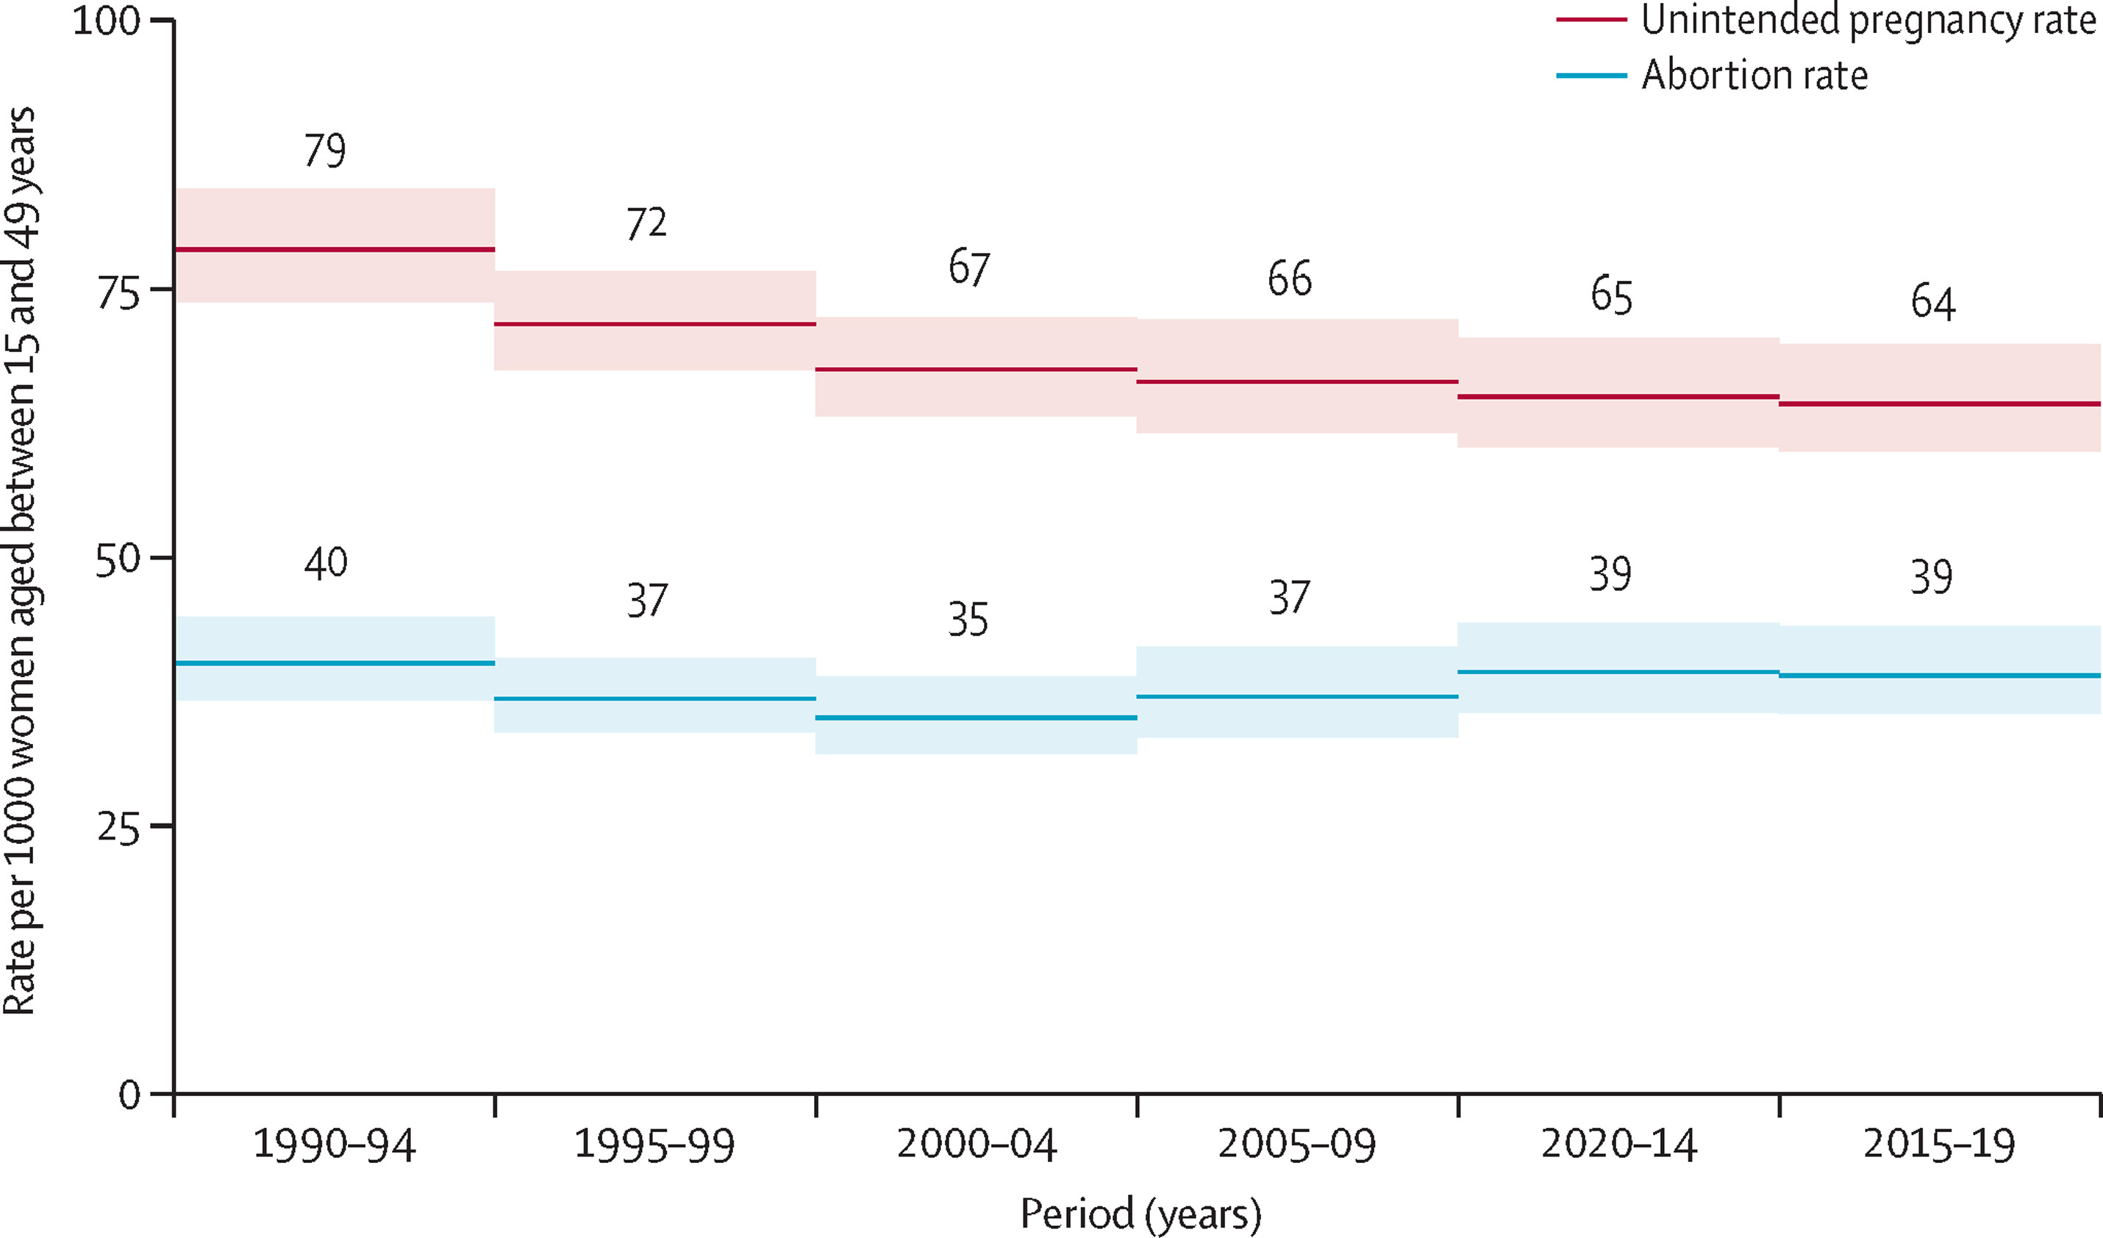
Magnitude of Abortion: Global
Unintended Pregnancies (2015–19):
121·0 million annually
64 per 1000 women aged 15–49.
Abortion rate (2015–19):
61% of unintended pregnancies ended in abortion
73·3 million abortions annually
39 per 1000 women aged 15–49
Source: Bearak et al, 2020
Notes:
Unintended pregnancy and abortion by income, region, and the legal status of abortion: estimates from a comprehensive model for 1990–2019

Slide 12
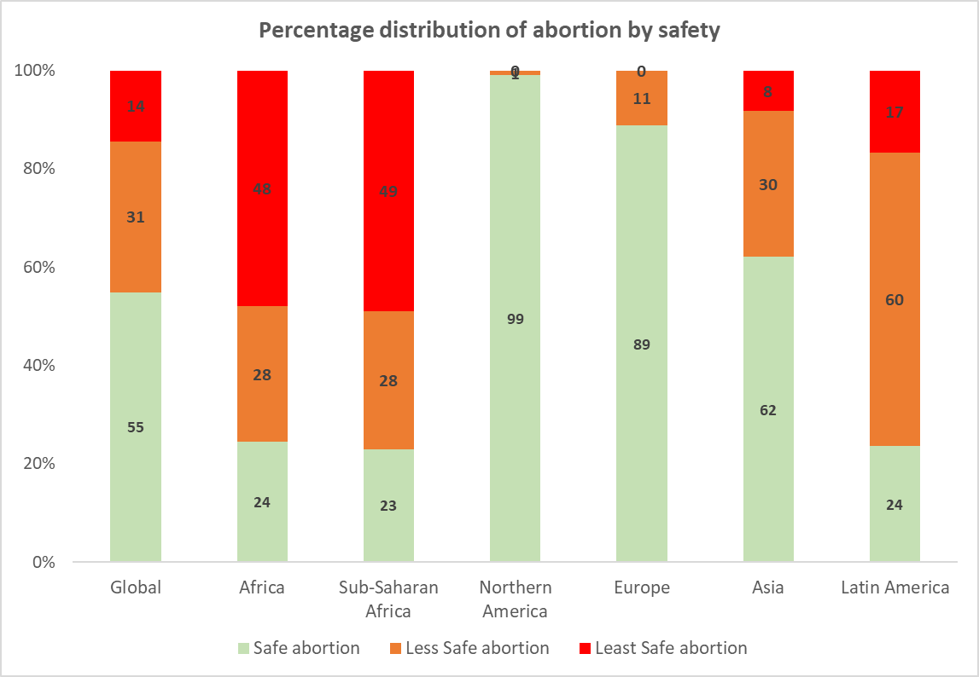
Globally, Africa (esp. Sub-Saharan Africa) has the highest proportion of unsafe abortion
Source: Global, regional, and subregional classification of abortions by safety, 2010–14: estimates from a Bayesian hierarchical model . The Lancet. 2017
Notes:
Bankole A et al., From Unsafe to Safe Abortion in Sub-Saharan Africa: Slow but Steady Progress, New York: Guttmacher Institute, 2020, https://www.guttmacher.org/report/from-unsafe-to-safe-abortion-in-subsaharan-africa. doi:10.1363/2020.32446
According to WHO, as of 2010–2014, about three-quarters (77%) of abortions in Sub-Saharan Africa are considered unsafe (the sum of less safe and least safe).2 Applying this proportion to the annual average of abortions estimated for 2015–20197 means that some 6.2 million women each year contend with the possible health consequences of unsafe abortions—consequences that would be avoided with safe procedures that adhere to WHO standards.
Abortion is riskier in Sub-Saharan Africa than in any other world region: As of 2010–2014, 77% of abortions in the region are unsafe, compared with the global average of 45%. The resulting incidence of unsafe abortion—6.2 million per year—exacts a heavy toll on the region’s women and families.

Slide 13
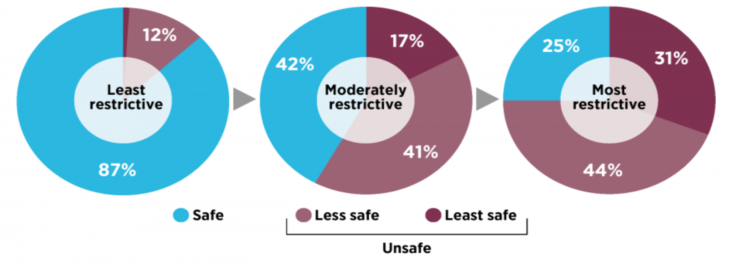
The proportion of abortions that are unsafe is much higher in countries where laws are more restrictive
Source: Guttmacher Institute, 2018
Notes:
https://www.guttmacher.org/gpr/2018/03/roadmap-safe-abortion-worldwide-lessons-new-global-trends-incidence-legality-and-safety
Shah I, Ahman E. Unsafe abortion: global and regional incidence, trends, consequences, and challenges. J Obstet Gynaecol Can. 2009 Dec;31(12):1149-58. PMID: 20085681.:
Legal restrictions on safe abortion do not reduce the incidence of abortion. A woman's likelihood to have an abortion is about the same whether she lives in a region where abortion is available on request or where it is highly restricted.
WHO: Sedgh et al. show that women all over the world are highly likely to have an induced abortion when
faced with an unplanned pregnancy – irrespective of legal conditions.10 However, where abortion laws
are the least restrictive there is no or very little evidence of unsafe abortion, while legal restrictions
increase the percentage of unlawful and unsafe procedures

Slide 14
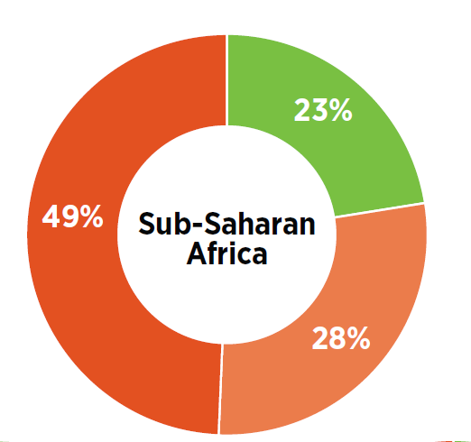
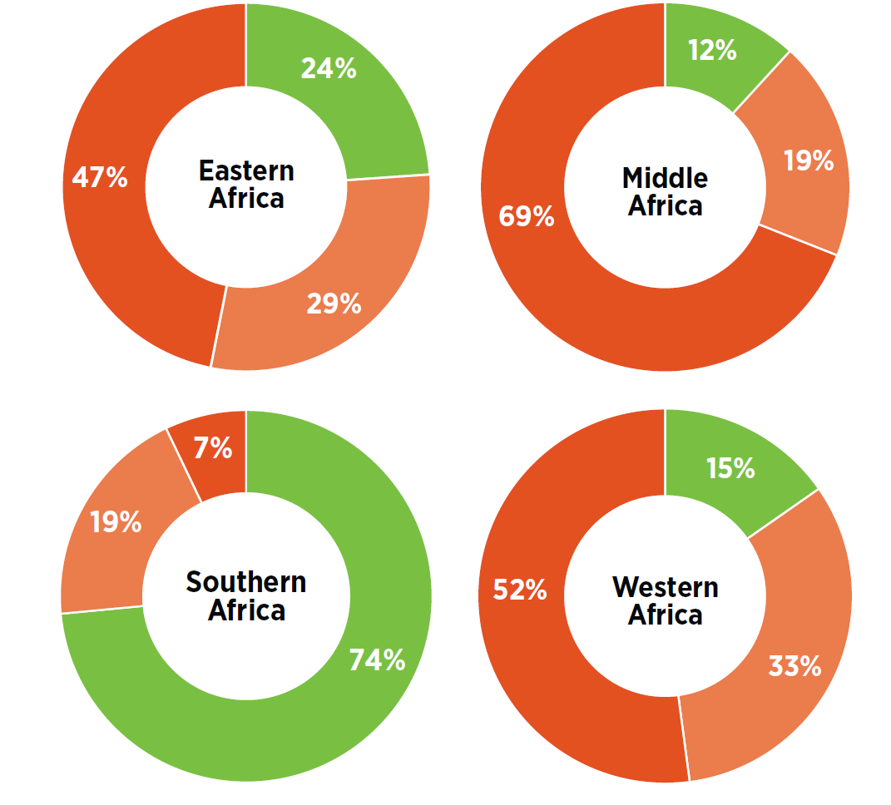
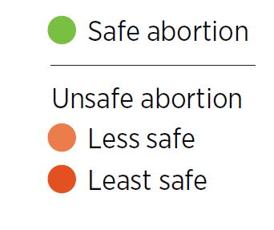
South Africa, where abortion is broadly legal, is the only SSA country in which safe abortion occur more than unsafe abortion
(SSA)
Source: Bankole A et al., 2020,
(data source: Ganatra et al, 2017)
Notes:
Bankole A et al., From Unsafe to Safe Abortion in Sub-Saharan Africa: Slow but Steady Progress, New York: Guttmacher Institute, 2020, https://www.guttmacher.org/report/from-unsafe-to-safe-abortion-in-subsaharan-africa
Based on data from 2010–2014, approximately 45% of all abortions worldwide were unsafe. (2)
Of all unsafe abortions, one third were performed under the least safe conditions, i.e. by untrained persons using dangerous and invasivemethods. (2)
In Latin American and Africa, the majority (approximately 3 out of 4) of all abortions are unsafe.
Estimates from 2012 indicate that in developing countries alone, an estimated 7 million women per year were treated in hospital facilities forcomplications of unsafe abortion (4).
Each year between 4.7% – 13.2% of maternal deaths can be attributed to unsafe abortion (3). In developed regions, it is estimated that 30women die for every 100 000 unsafe abortions. That number rises to 220 deaths per 100 000 unsafe abortions in developing regions and 520deaths per 100 000 unsafe abortions in sub-Saharan Africa.
In Africa, nearly half of all abortions happen in the least safe circumstances. Moreover, mortality from unsafe abortion disproportionately affectswomen in Africa. While the continent accounts for 29% of all unsafe abortions, it sees 62% of unsafe abortion-related deaths (2)
(1)
Bearak J, Popinchalk A, Ganatra B, Moller A-B, Tunçalp Ö, Beavin C, Kwok L, Alkema L. Unintended pregnancy and abortion by income, region, and the legal status of abortion: estimates from a comprehensive model for 1990–2019.
Lancet Glob Health. 2020 Sep; 8(9):e1152-e1161. doi: 10.1016/S2214-109X(20)30315-6.
(2)
Ganatra B, Gerdts C, Rossier C, Johnson Jr B R, Tuncalp Ö, Assifi A, Sedgh G, Singh S, Bankole A, Popinchalk A, Bearak J, Kang Z,Alkema L.
Global, regional, and subregional classification of abortions by safety, 2010–14: estimates from a Bayesian hierarchical model
. TheLancet. 2017 Sep
(3)
Say L, Chou D, Gemmill A, Tunçalp Ö, Moller AB, Daniels J, Gülmezoglu AM, Temmerman M, Alkema L. Global causes of maternal death: aWHO systematic analysis. Lancet Glob Health. 2014 Jun; 2(6):e323-33.
(4)
Singh S, Maddow-Zimet I. Facility-based treatment for medical complications resulting from unsafe pregnancy termination in the developingworld, 2012: a review of evidence from 26 countries. BJOG 2015; published online Aug 19. DOI:10.1111/1471-0528.13552.
(5)
Vlassoff et al. Economic impact of unsafe abortion-related morbidity and mortality: evidence and estimation challenges. Brighton, Institute ofDevelopment Studies, 2008 (IDS Research Reports 59).
(6)
L Haddad. Unsafe Abortion: Unnecessary Maternal Mortality. Rev Obstet Gynecol. 2009 Spring; 2(2): 122–126.
(7)
Human Rights Committee; Committee Against Torture; Committee on the Elimination of Discrimination Against Women.

Slide 15
The Abortion Landscape & Scope: National

Slide 16
Despite legal restrictions, abortions are fairly common in Nigeria
Induced abortion is legally restricted in Nigeria except when performed to save a woman’s life
Most unintended pregnancies in Nigeria end in abortion (56% in 2012) ¹
2012 estimates¹ suggest that 1.25 million induced abortions occurred in Nigeria (33 abortions per 1000 women aged 15–49)
More recent studies (2017-18) estimate 1.8 - 2.7 million abortions in Nigeria annually² (1-year incidence of 29.0/1,000 women aged 15 – 49 from respondents & 45.8/1000 women from confidantes)³
Sources: (1), Bankole A et al., The incidence of abortion in Nigeria, International Perspectives on Sexual and Reproductive Health, 2015, 41(4):170–181. (2.) PMA2020 Abortion Survey Results: Nigeria, April – May 2018 . (3) Bell SO, et al. Inequities in the incidence and safety of abortion in Nigeria. BMJ Global Health. 2020;5:e001814. doi:10.1136/bmjgh-2019-001814
Notes:
2017 Estimate: https://www.pmadata.org/sites/default/files/data_product_results/PMA2020-Nigeria-National-R3-Abortion-Brief.pdf
Sources: (1), Bankole A et al., The incidence of abortion in Nigeria, International Perspectives on Sexual and Reproductive Health, 2015, 41(4):170–181. (2.) PMA2020 Abortion Survey Results: Nigeria, April – May 2018 . (3) Bell SO, et al. Inequities in the incidence and safety of abortion in Nigeria. BMJ Global Health. 2020;5:e001814. doi
Bell SO, Omoluabi E,
OlaOlorun F, et al. Inequities
in the incidence and
safety of abortion in
Nigeria. BMJ Global Health
2020;5:e001814. doi:10.1136/
bmjgh-2019-001814

Slide 17
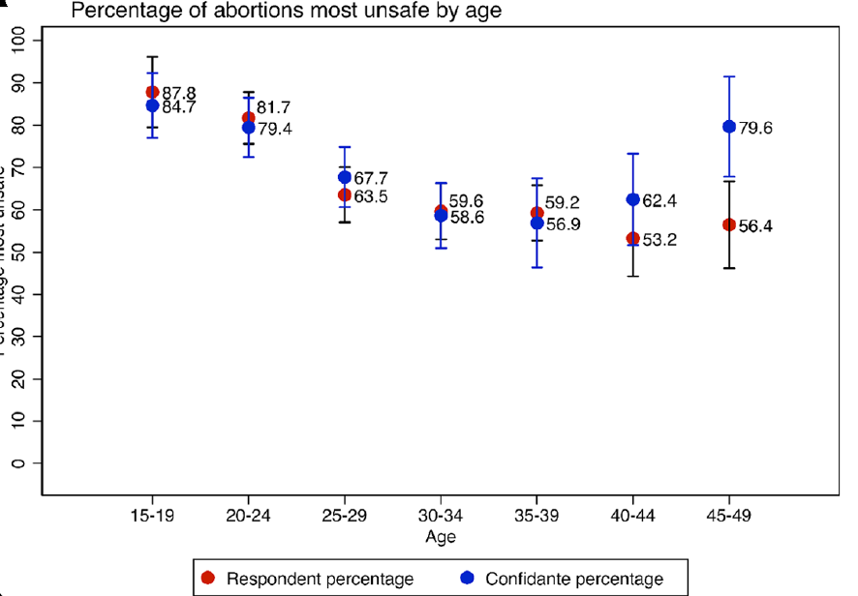
Abortions in Nigeria are mostly unsafe
Approximately two-thirds of abortions in Nigeria are unsafe (63-69%)
Source: Bell SO, et al. Inequities in the incidence and safety of abortion in Nigeria. BMJ Global Health. 2020;5:e001814. doi:10.1136/bmjgh-2019-001814
Notes:
Bell SO, Omoluabi E,
OlaOlorun F, et al. Inequities
in the incidence and
safety of abortion in
Nigeria. BMJ Global Health
2020;5:e001814. doi:10.1136/
bmjgh-2019-001814

Slide 18
Abortion-seeking and Unsafe Abortion in Nigeria: Women’s Characteristics
Young women (20-29 years), women with secondary or higher education and women in urban areas being the most likely to have had an abortion in the prior year¹
Women aged 15–19, women who had never attended school and the poorest women were significantly more likely to have had the most unsafe abortions¹
Women who experienced abortion complications only presented to health facilities as a last resort²
Sources: (i) PMA2020 Abortion Survey Results: Nigeria, April – May 2018; (2) Oyeniran AA et al. (2019)
Narratives of women presenting with abortion complications in Southwestern Nigeria: A qualitative study. PLoS ONE 14(5): e0217616.https://doi.org/10.1371/journal.pone.0217616
Notes:
Sources: (i) PMA2020 Abortion Survey Results: Nigeria, April – May 2018; (2) Oyeniran AA et al. (2019)
Narratives of women presenting with abortion complications in Southwestern Nigeria: A qualitative study. PLoS ONE 14(5): e0217616.https://doi.org/10.1371/journal.pone.0217616

Slide 19
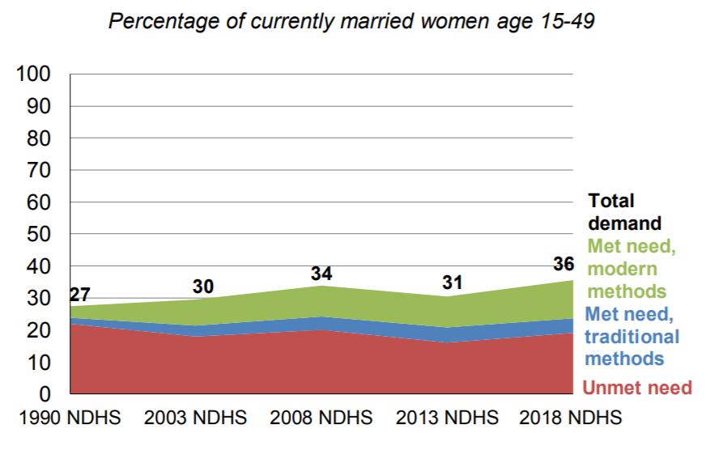
Poor contraceptive use & service gaps increases the risk of unintended pregnancy
Trends in demand for family planning in Nigeria
Contraceptive use is very low in Nigeria (12% for modern methods & 17% for all methods in 2018 among currently married women)
About 1 in 5 women (19%) have an unmet need for family planning: If all currently married women who want to space or limit their children were to use a family planning method, Nigeria’s contraceptive prevalence rate would increase from 17% to 36%
Source: Nigeria DHS 2018
Notes:
Unmet need for family planning
Proportion of women who (1) are not pregnant and not postpartum amenorrhoeic and are
considered fecund and want to postpone their next birth for 2 or more years or stop childbearing
altogether but are not using a contraceptive method, or (2) have a mistimed or unwanted current
pregnancy, or (3) are postpartum amenorrhoeic and their last birth in the last 2 years was
mistimed or unwanted.
Sample: All women age 15-49, currently married women age 15-49, and sexually active
unmarried women age 15-49

Slide 20
Notes:
https://www.guttmacher.org/sites/default/files/infographic_attachment/452_nigeria_infographic_final.pdf

Slide 21
Lack of Acess to Safe Abortion Options May Cause Women to Seek Unsafe Approaches
Source: Stillman et al: Women's self-reported experiences using misoprostol obtained from drug sellers: a prospective cohort study in Lagos State, Nigeria. BMJ Open. 2020 May 5;10(5):e034670.
Notes:
Describes the actions women would have taken in the absence of misoprostol – at least 11% would have take taken some actions with significant health risk
Further studies: Who would have sough further help

Slide 22
Implications of Nigeria’s high burden of unsafe abortion

Slide 23
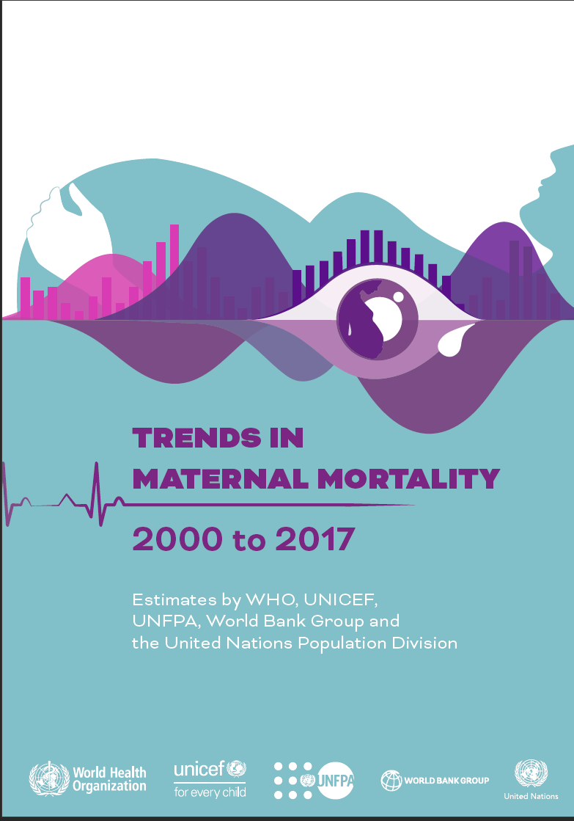
Unsafe abortion results in high level of maternal deaths
Nigeria has the highest burden of maternal mortality in the world: approximately 67,000 in 2017
If abortion is associated with 11% of maternal deaths as indicated by FMOH: About 7,370 maternal deaths are due to unsafe abortion in Nigeria yearly
Approximately 20 maternal deaths from unsafe abortion daily!
Notes:
Nigeria and India had the highest estimated
numbers of maternal deaths, accounting for
approximately one third (35%) of estimated
global maternal deaths in 2017, with
approximately 67 000 and 35 000 maternal
deaths (23% and 12% of global maternal
deaths), respectively

Slide 24
What is the Relative Cost of Abortion in sub-Saharan Africa?
 | Cost to Patients | Cost to the Health System
Spontaneous vaginal delivery | USD 6–52 | USD 8–73
Abortion | USD 11–66 | USD 40–298
Post-abortion care | USD 21–158 | USD 46–151
Cesarean section | USD 56–377 | USD 80–562
Source: Mori AT et al, 2020
Notes:
Mori AT, Binyaruka P, Hangoma P, Robberstad B, Sandoy I. Patient and health system costs of managing pregnancy and birth-related complications in sub-Saharan Africa: a systematic review. Health Econ Rev. 2020 Aug 15;10(1):26. doi: 10.1186/s13561-020-00283-y. PMID: 32803373; PMCID: PMC7429732.

Slide 25
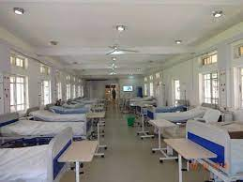
Abortion has huge cost for the Nigerian health system
A previous study suggests that the cost of treating the complications of unsafe abortion may be as high as 3.5% of the total expenditure of public health care
Source: Bankole et al., 2007.
Notes:
Bankole A, Singh S, Vlassof M, Woog V. Estimating the cost of post-abortion care in Nigeria: a case study. In: Lule E, Singh S, Chowdhury SA, eds. Fert In: Lule E, Singh S, Chowdhury SA, eds. Fertility Regulation Behaviors and Their Costs. Washington, DC: World Bank; 2007
The data spoke of 2005

Slide 26
Reducing the Burden & Impact of Unsafe Abortion in Nigeria: What are the Ways Forward?

Slide 27
Discussion
What actions do we need to undertake to reduce the burden and Impact of unsafe abortion in Nigeria?

Slide 28
A Public Health Framework for Interventions
Tertiary prevention
Secondary prevention
Primary prevention
Primordial prevention
Rehabilitation
Early Diagnosis & Prompt Treatment
Disability limitation
Health promotion
Specific Protection
Alter societal structures & thereby address sytemic level determinants

Slide 29
Strategic Intervention Pillars
1. Actions to reduce incidence of abortion
2. Actions to increase access to safe abortion care
3. Actions to reduce negative impact of unsafe abortion

Slide 30
Strategic Intervention Pillars & Key Actions….
Actions to reduce incidence of abortion
Improved knowledge of key groups (e.g. Young people)
Improved contraceptive behaviour
Improved access to modern contraceptives

Slide 31
Strategic Intervention Pillars & Key Actions…
2. Actions to increase access to safe abortion care
Improved knowledge of safe abortion care
Reduction of barriers to access
Stigma
Policy & legal issues
Others
Improved access to care
Health workers dimension
Facility dimension
Client dimension

Slide 32
Strategic Intervention Pillars & Key Actions
3. Actions to reduce negative impact of unsafe abortion
Improved access to quality post-abortion care (PAC)
Increased knowledge of PAC at community level
Increase in number of facilities providing PAC services (health workers, service infrastructure etc)
Quality assurance of PAC services
Reduced stigma regarding post-abortion care

Slide 33
Last Words

Slide 34
Last Words: From Research to Actions: Some Reflections
What gaps exist in our knowledge of abortion incidence?
Consider the public health framing of “what, where, when, who, why, how?”
How can we close that gap in terms of research:
Think prevention (primordial, primary, secondary, tertiary)
Consider different sectors, inter-sectorally and multi-sectoral
How can we effectively use the evidence we are able to generate:
Academic engagements and forums
Policy engagements

Slide 35
Study Materials/References/Further Reading
Bankole A, Adewole IF, Hussain R et al. The Incidence of Abortion in Nigeria. Int Perspect Sex Reprod Health. 2015 Dec;41(4):170-81. doi: 10.1363/4117015.
Bell SO, Omoluabi E, OlaOlorun F et al. Inequities in the incidence and safety of abortion in Nigeria. BMJ Glob Health. 2020 Jan 7;5(1):e001814. doi: 10.1136/bmjgh-2019-001814.
Bearak JM, Popinchalk A, Beavin C et al. Country-specific estimates of unintended pregnancy and abortion incidence: a global comparative analysis of levels in 2015-2019. BMJ Glob Health. 2022 Mar;7(3):e007151. doi: 10.1136/bmjgh-2021-007151.
Fathalla MF. Safe abortion: The public health rationale. Best Pract Res Clin Obstet Gynaecol. 2020 Feb;63:2-12. doi: 10.1016/j.bpobgyn.2019.03.010.
Stillman M, Owolabi O, Fatusi AO, Akinyemi AI et al. Women's self-reported experiences using misoprostol obtained from drug sellers: a prospective cohort study in Lagos State, Nigeria. BMJ Open. 2020 May 5;10(5):e034670. doi: 10.1136/bmjopen-2019-034670.

Slide 37
Questions Time

