Slide 1
Session 3 Respondents within Facilities Key questions Past/Average month (or yr.) caseloads
September 10, 2020
Ann M. Moore

Slide 2
Respondents within Facilities

Slide 3
HFS Respondents (1)
In each facility we interview a key person who is knowledgeable on postabortion care at the health facility
Could be facility director, Chief OB/GYN, nurse in charge
Must know about all the ways that women are arriving with PAC at that facility
Sometimes two people are equally well suited—choose one
We emphasize confidentiality, indicating that findings will not be published at the individual facility level.
Notes:
HFS interviewees are facility staff knowledgeable about the facility’s provision of abortion services, such as the head of the OB/GYN department, director of the facility etc.
We emphasis to them that the identify of the respondent and facility will be kept confidential and the findings will not be presented at individual facility level.

Slide 4
HFS Respondents (2)
Interview usually takes 30-45 minutes
Interviewer needs to wait around till appropriate provider is available & not settle for less knowledgeable person who is available
Hardest part is discouraging respondent from consulting medical log
The critical questions on estimated caseload require a discussion with the respondent and should not be rushed

Slide 5
Health Facilities Survey: Key questions

Slide 6
HFS: Key questions
Does this facility treat women with complications from spontaneous or induced abortions?
If no, the respondent will skip all PAC-related questions
In this facility, are post-abortion care patients treated as outpatients, inpatients or both?
We ask for estimates separately for inpatients and outpatients to ensure a more complete count
Notes:
In the interst of time, I will only talk about the questions we ask to obtain the counts of post abortion complications treated. We have a separate set of questions for the counts of legal abortions where we collect that information.
We first ask the respondent whether the facility treat complications from spontaneous or induced abortions.
If the answer is “YES”, we ask whether posl abortion care patients are treated as outpatients, inpatients or both in that facility
Some facilities will be outpatient care only.

Slide 7
HFS: Key questions
During an AVERAGE month (or year), about how many post-abortion care cases are treated as OUTPATIENTS? As INPATIENTS?
During the PAST month (or year), about how many post-abortion care cases are treated as OUTPATIENTS? As INPATIENTS?
Responses to these questions are the sources of our PAC calculations
Notes:
Our default time unit is month—most respondents should be able to estimate PAC cases for typical and past month. However, some small facilities or those that perform very little PAC, may find it difficult to estimate for months but are able to do for year.
To allow for cases like this, we provide for the alternative of estimating the number in a typical year and past year.

Slide 8
When to use annual caseloads
Smaller facilities
Decide if you want to advise interviewers to treat month as 1-31 and year Jan to December
OR
The last 30 days or the last 12 months
Results should be the same

Slide 9
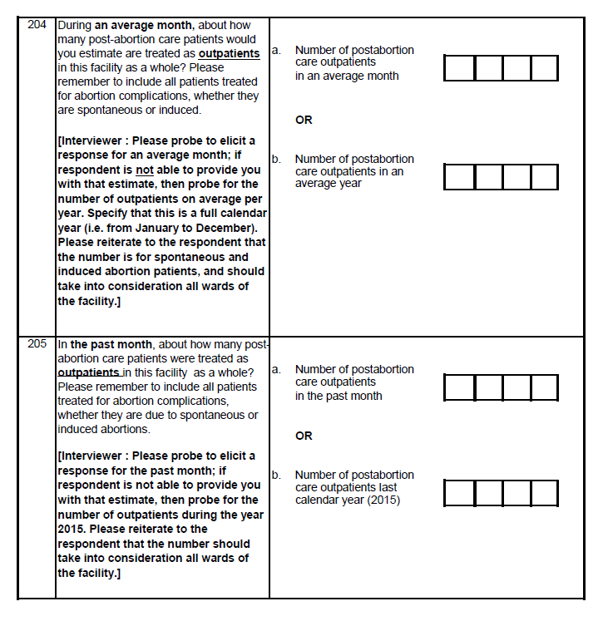

Slide 10
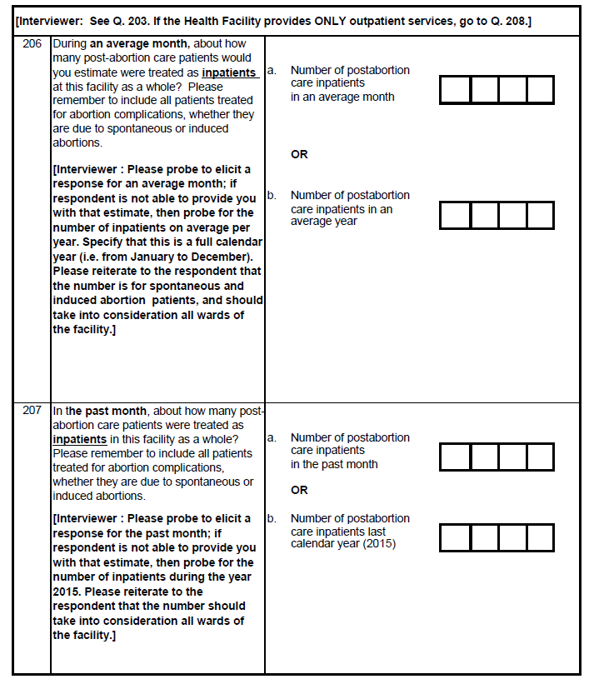

Slide 11
Do you want to see this in ODK output?

Slide 12
Past/Average month (or yr.) caseloads

Slide 13
For each facility providing PAC:
We arrive at annual total PAC cases, for average and past month, separately for outpatients and for inpatients
We average the typical(average) and past year estimates for outpatients and inpatients separately
Sum the average values of outpatient and inpatient estimate to get TOTAL yearly PAC cases for facility
Add all facility estimates to get total number of PAC cases for the sample
Notes:
CALCULATION:
Step 1: Calculate for each facility the yearly total of PAC counts for both estimates: typcial months and past months, separately for outpatients and inpatients
Step 2: Calcuate the average of typical and past year separately for outpatients and inpatients
Step 3: Sum the estimates for outpatients and inpatents
Step 4: Add up the estimates for all facilities to get the tital number of PAC in the sampled facilities.

Slide 14
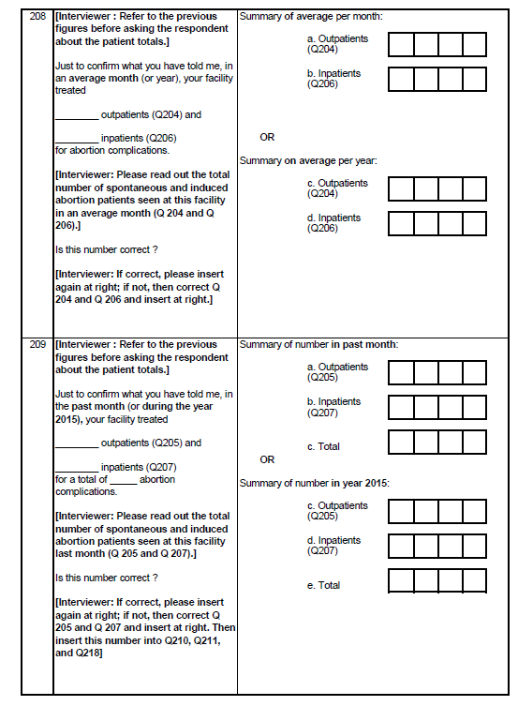

Slide 15
Example: one large facility
Uganda General Hospital
Patient type | Given estimate |  |  | Yearly calculation | Total PAC cases/year
Outpatients | Typical month | 30 | x12 | 360 | 324
 | Past month | 24 | x12 | 288
Inpatients | Typical month | 20 | x12 | 240 | 216
 | Past month | 16 | x12 | 192
TOTAL |  |  |  |  | 540

Slide 16
Session 4 Other optional modules
September 10, 2020
Ann M. Moore

Slide 17
Big decision points
Whether to collect information on legal abortion services
How much to include about misoprostol/medication abortion
# of patients who arrive with medication abortion in process

Slide 18
Smaller decision points (1)
MCH services
Available & Functional/Available/Not Available
Other infrastructure/supplies
Commonly//Sometimes/Rarely/Never
Essential medicines
Facility supplies/Woman supplies/Stock-outs
Other essential tests that the health facility can run

Slide 19
Smaller decision points (2)
Hours when services are available
Training of those who provide PAC
Who provided training
Are there others who are eligible for training who don’t have it
Conscientious objection

Slide 20
Smaller decision points (3)
Whether to try to track where respondents come from
This depends on the geographic breakdown you intend to do during analysis
Will impact both the HFS q’tnaire and the HPS sample

Slide 21
Smaller decision points (4)
Severity of complications
Specific complications
Classification of those complications
Whether they are from MA
Near miss
Maternal mortality
Treatments used: all & most common

Slide 22
Smaller decision points (5)
Breakdown of PAC patients
Age (could do multiple breaks)
Second-trimester PAC
Spontaneous abortion & spontaneous abortion in the second trimester

Slide 23
Smaller decision points (6)
Referrals--# referred
To health facility & reason why
From health facility & reason why
Where women were referred
Whether women will make it to that facility
Barriers to making it to referred facility

Slide 24
Smaller decision points (7)
Costs of PAC
Whether lack of money is source of delay or leads to denial of care

Slide 25
Smaller decision points (8)
Postabortion contraceptive counseling
Topics covered
Methods offered/not offered
Reasons for not offering other methods
To whom – is parental consent needed
Who accepts, referral
Why women refuse

Slide 26
Smaller decision points (9)
Respondents’ opinions on:
How treatment could be improved
Knowledge of law
Perspective on law

Slide 27
Smaller decision points (10)
Medical record review
PAC
Legal abortion
Whether you want to interview >1 respondent
Interviewer observations

Slide 28
Topics to be covered in HFS (1)
Facility infrastructure
Numbers of services provided [where abortion is highly restricted]:
# of patients treated for postabortion complications (PAC)
past month and average month
Severity of complications
If medication abortion is present:
# of patients who arrive with medication abortion in process

Slide 29
Topics to be covered in HFS (2)
Capacity to provide PAC
Necessary equipment, drugs and supplies
Trained staff; hours open
Measures of quality of care
Use of appropriate procedures for treating PAC
Reasons for rejecting women seeking services
Referral services
Knowledge about law (conscientious objection?)
Contraceptive counseling and services
Differences by type of provider, sector and state

