Slide 1
Session 7: Separating cases due to induced and spontaneous abortions
October 1, 2020
Onikepe Owolabi

Slide 2
What is a spontaneous abortion?
It is one which is not induced, even if an external cause is involved such as trauma or communicable disease
It is also called “miscarriage”
It is much more common in the 1st trimester but can happen in the second trimester
It doesn’t always complete on its own and therefore can sometimes lead to complications and require postabortion care
There are very few studies which have accurately measured miscarriage at a population level, with no reliable studies in LMICs

Slide 3
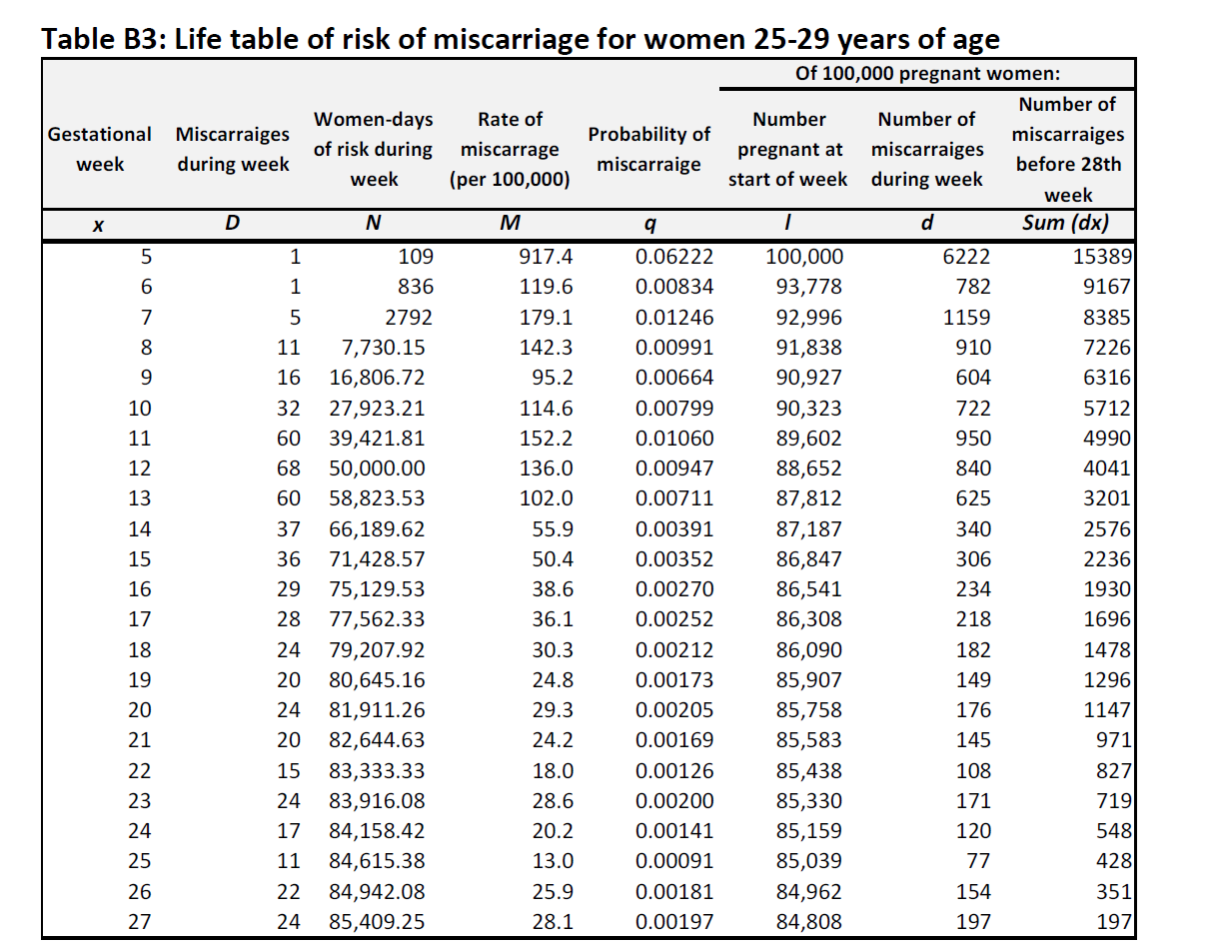
Sample life table showing risk of miscarriage by gestational age
Sully, E., Dibaba, Y., Fetters, T., Blades, N., & Bankole, A. (2018). Playing it safe: legal and clandestine abortions among adolescents in Ethiopia. Journal of Adolescent Health, 62(6), 729-736.

Slide 4
Total number of Induced PAC cases
Total number of PAC cases =
Cases due to induced abortions + Cases due to spontaneous abortions
Therefore, Total number of cases due to Induced abortions=
Total number of PAC cases – Cases due to spontaneous abortions(miscarriages)

Slide 5
Two assumptions to estimate number of cases due to miscarriages
Most miscarriages which will require health facility care (admissions) are late miscarriages (13-22 weeks gestational age)
Not all women with late miscarriages will seek care in a health facility.
Notes:
Embedded herein is an assumption that it is miscarriages that require healthcare that come in. This does not necessarily take into account womens careseeking for vaginal bleeding and may change the proportion if many women with later first trimester bleeding (after 9 weeks) choose to seek care .

Slide 6
Assumption 1: Estimating the number of late miscarriages
Clinical studies on the biological pattern of miscarriages suggest that late pregnancy loses account for 2.9% of all recognized pregnancies.
Since live births are estimated to account for 84.8% of all pregnancies, late miscarriages hence account for 3.41% of all live births
Main data needed: Number of births
  National census, most preferably for the year of study
  United Nations Department of Population’s population estimates and projections: https://population.un.org/wpp/Download/Standard/Population/
  If not available, it can be estimated by applying age specific birth rates from the DHD or DHS type survey to 5-year age distribution of women of reproductive age.
(2.9/84.8*100).

Slide 7
Estimating the annual number of births in Mainland Tanzania

Slide 8
Assumption 1: Estimating the number of late miscarriages (2)
Total number of births = 1,852,294
Estimated total number of late miscarriages in Tanzania:
3.41% X total number of births in country =
3.41% X 1,852,294 = 0.0341 X 1,852,294 = 63,163 late miscarriages

Slide 9
Assumption 2: Calculating the number of late miscarriages that seek care in health facilities
Proxy data used: The proportion of women with recent births who delivered in health facilities or who did not do so because it is not necessary or customary, total and by region
We add in the second group of women because we assume that they might seek care for abortion-related complications since these are not births
Data source: Demographic and Health Survey or from a DHS-type survey
The survey should be nationally representative, preferably a probability sample survey. If that is not available, a survey with national focus or coverage might be used.

Slide 10
Obtaining the proportion of women who did not deliver in health facilities but are likely to seek PAC
Reasons for delivering outside facility by women who had non facility births

Slide 11
Obtaining the proportion of women who did not deliver in health facilities but are likely to seek PAC (2)
Data on reasons for not care seeking in 2010, shows that 30.24% out of those who did not deliver in health facilities did not do so for customary (non-access) reasons.
We want to estimate the proportion of women not delivering for customary reasons out of All Births not just non-facility deliveries
We also want to estimate the proportion of these women in 2013 which is the year of AICM data collection

Slide 12
Obtaining the proportion of women who did not deliver in health facilities but are likely to seek PAC (3)
 | 1996 % delivered in facility | 1999 % delivered in facility | 2004 % delivered in facility | 2010 % delivered in facility | 2010 delivered in facility + did not for customary reasons | Annual % change | 2013% delivered in facility | 2013 delivered in facility + did not for customary reasons
Formula |  |  |  |  | 50.2+(30.24/100*(100-50.2) | 50.2-47/14 | 50.2+0.23*3 | 50.89*65.26/50.2
Proportion | 47.0 | 43.7 | 47.0 | 50.2 | 65.26 | 0.23 | 50.89 | 66.15

Slide 13
Assumption 2: Estimating the number of late miscarriages that seek care in health facilities (2)
Projected proportion of women in Mainland Tanzania who delivered in health facilities in 2013: 50.89%
Estimated proportion of women in Mainland Tanzania who did not deliver in health facilities in 2013 due to customs: 15.26%
Proportion of women who might seek care for PAC in Mainland Tanzania in 2013:
Proportion delivering in health in health facilities + Proportion not delivering with reasons related to custom/culture
50.89% + 15.26% = 66.15%

Slide 14
Assumption 2: Estimating the number of late miscarriages that seek care in health facilities (3)
Total number of births = 1,852,294
Estimated total number of late miscarriages in Mainland Tanzania:
3.41 X total number of births in country=
3.41% X 1,852,294 = 0.0341 X 1,852,294 = 63,163 late miscarriages
Number of late miscarriages that seek care in Mainland Tanzania=
Proportion of those who might seek PAC X Estimated number of late miscarriages
66.15% X 63,163 = 41,782 estimated late miscarriages that sought PAC

Slide 15
Total PAC case load

Slide 16
Calculating the number of PAC cases due to induced abortions
Total number of Induced PAC cases:
Total number of PAC cases – Cases due to spontaneous abortions (estimated late miscarriages that seek care in a health facility)
Total number of PAC cases in Tanzania Mainland = 96885
Number of late miscarriages that seek care in Mainland Tanzania:
66.15% X 63,163 = 41,782 estimated late miscarriages that sought care for abortion
Total number of induced PAC cases in Mainland Tanzania=
96,885 – 41,782 = 55,103

Slide 17
Additional comments
These calculations can be done at the subnational level if data was collected to provide representative estimates at those levels.

