Slide 1
Session 9: Likelihood of having complications by provider type & Proportion of women receiving care for abortion complications in facilities
October 1, 2020
Onikepe Owolabi

Slide 2
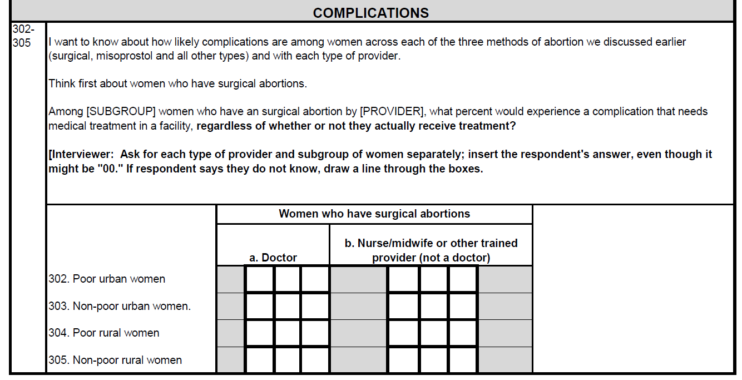
Likelihood of complications (surgical abortions)
Zimbabwe questionnaire Q302-313

Slide 3
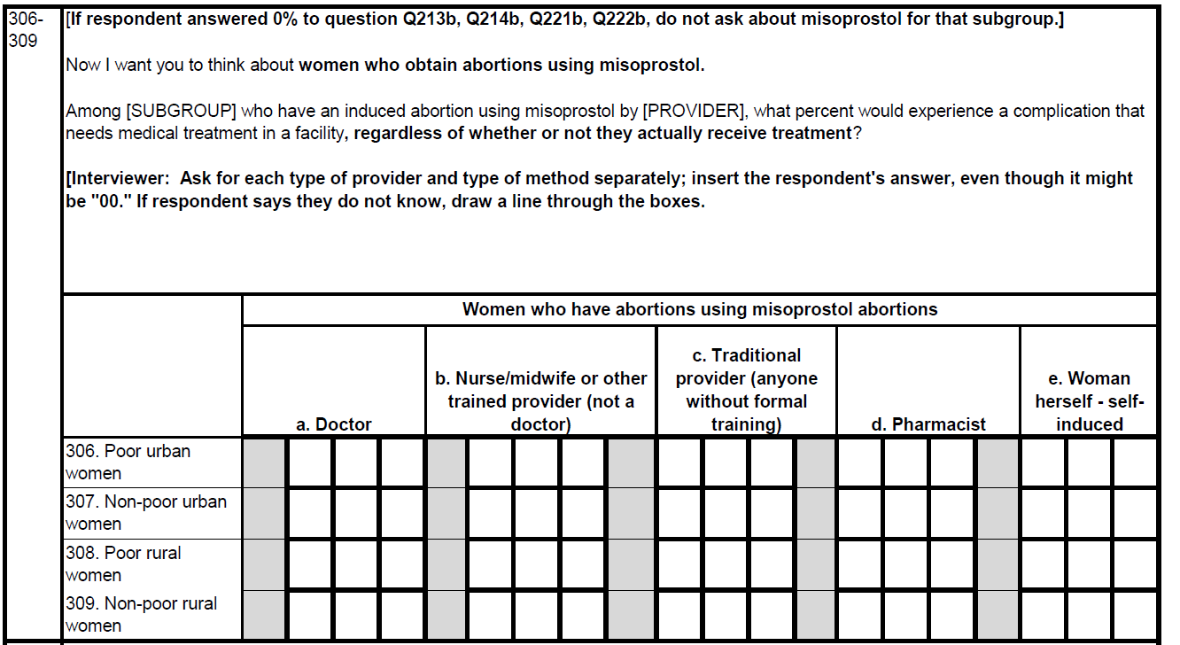
Likelihood of complications (medical abortions)
Zimbabwe questionnaire Q302-313

Slide 4
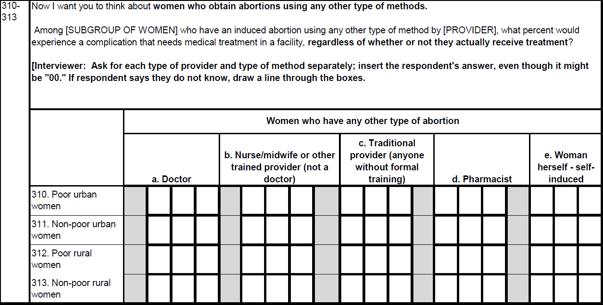
Likelihood of complications (other complications)
Zimbabwe questionnaire Q302-313

Slide 5
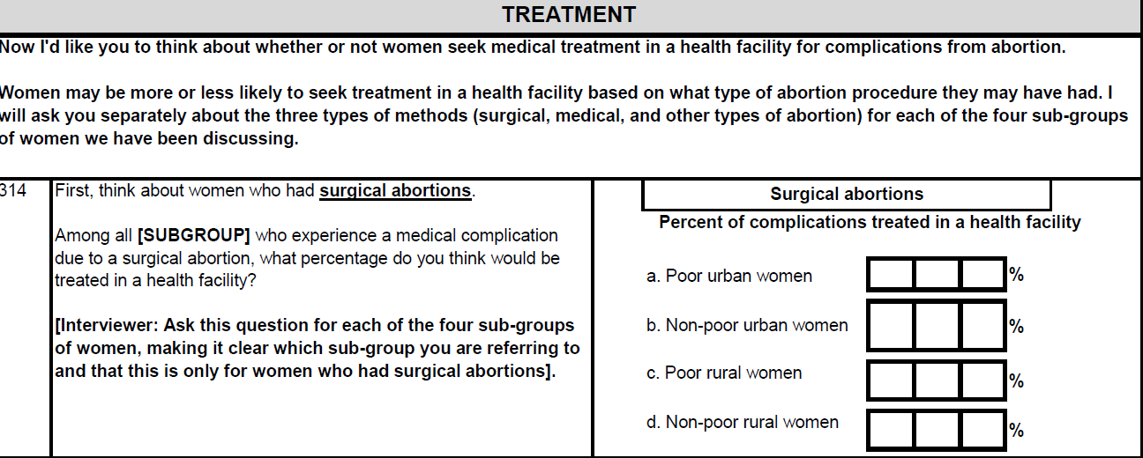
Proportion treated for complications (surgical abortions)
Zimbabwe questionnaire Q314-316

Slide 6
Proportion treated for complications (surgical abortions)
Zimbabwe questionnaire Q314-316

Slide 7
Proportion treated for complications (surgical abortions)
Zimbabwe questionnaire Q314-316

